Slide 1

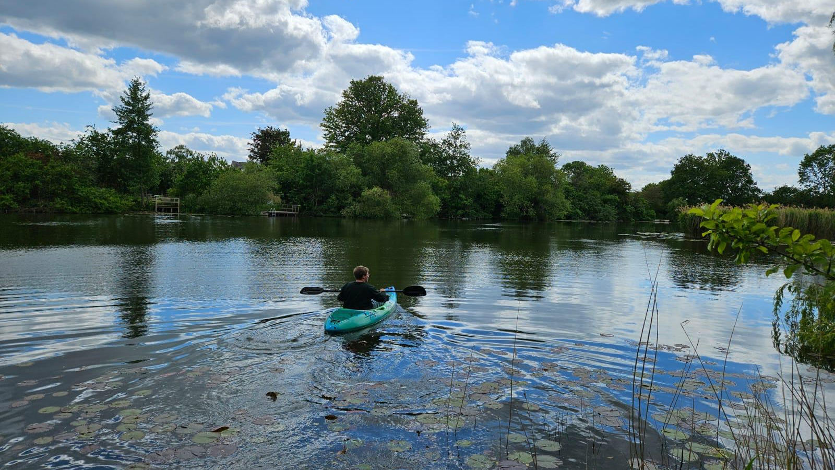
INTERGENERATIONAL ROUNDTABLE
Fenlands Restoration for
Flood Defence & Water Quality
Global Youth Council on Science, Law & Sustainability
× Policy Leaders, Scientists & Community of Cambridgeshire
Wednesday 22 July 2026 • 1:00 – 2:30pm
Cambridge City Council Guildhall, Cambridge — and Online
Restoring Our Fens

Slide 2
WHAT WE'LL COVER
Introduction & Outline
1
Education: Our commitment to school and youth learning-by-doing
Restoring Our Fens schools workshops, and our Heron Habitat Helpers Handbook for younger youth
2
Engagement: Our ideas and local / global policy proposals
Wetlands City accreditation for Cambridge / Peterborough, and our SDG 6 Journal special issue
3
Emergency Impact: Our future generations declaration and petition
Youth Declaration on Fenlands for Future Generations, and our call for green infrastructure and nature-based solutions
4
Questions for Policy Leaders, Scientists & Community
Framing questions to open the discussion across generations

Slide 3

Wetlands & Our Fens
How wetlands reduce flood risk, store carbon and provide homes for nature and people
Notes:
Divider for Part 2 over a lily-pad lake photo.

Slide 4
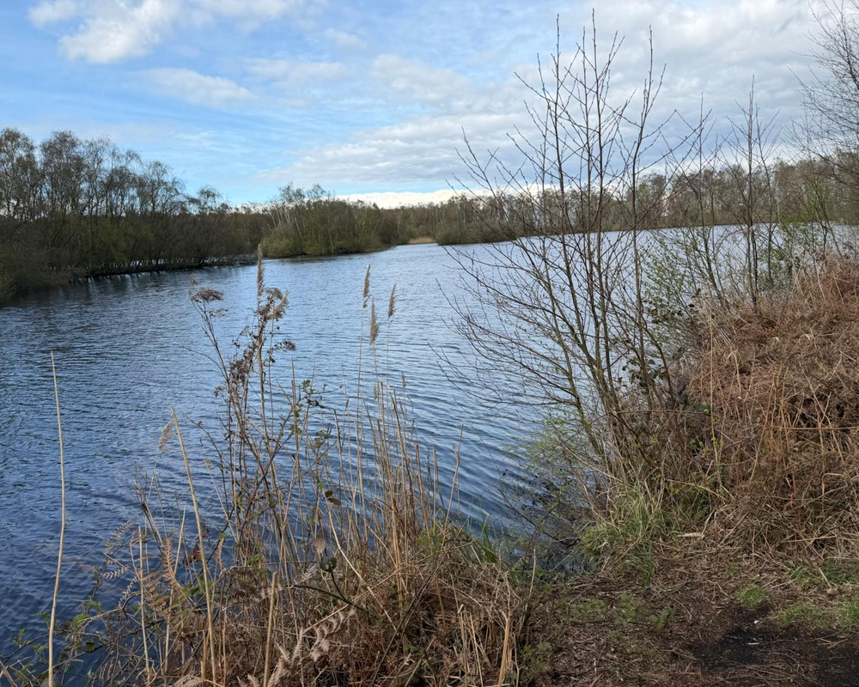



What is a wetland?
Land saturated with water for much of the year — a transition between land and open water, and one of the most biodiverse habitats there is.
Always soggy
Reeds & rushes
Acts like a natural sponge, storing water.
Water-tolerant plants that slow and filter flow.
Bursting with life
Cleans water
Rich biodiversity — birds, amphibians, fish and invertebrates.
Vegetation traps sediment and removes pollutants.
A real Fenland wetland
Notes:
Lovely content kept, design swapped to use a real wetland photo panel. Wicken Fen is the nearby living example if pupils have visited.

Slide 5




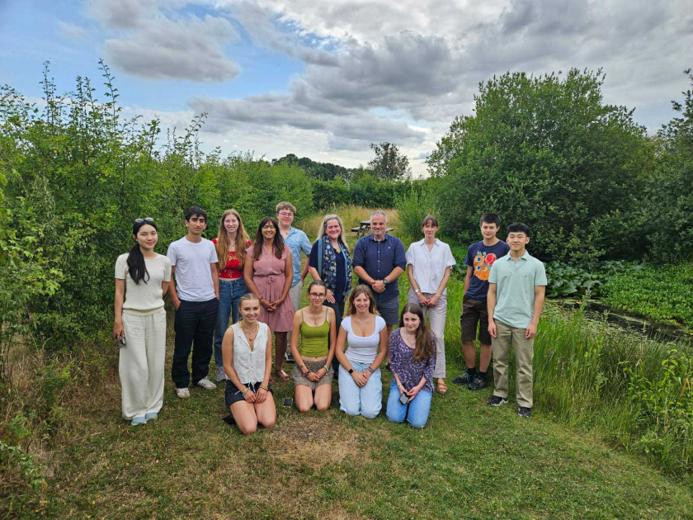


The story of the Fens
The landscape around Cambridge has been transformed by people — it was not always farmland.
Long ago
People drain it
Rich farmland
The catch
A vast natural wetland of water, reedbeds and wildlife.
From the 1600s, engineered ditches and pumps drained the water for agriculture.
The drained peat became highly fertile, productive farmland.
But exposed peat shrinks and oxidises, so the land sank below the rivers.
Over to you: can you name a very OLD settlement in the Fens, and a much NEW one? (For example Ely, Wicken or Whittlesea — versus a recent development.)
Add photos: Holme Fen, Wicken Fen, River Cam, Ouse, Nene
Notes:
Story kept (terrific content). Added: a place-name quiz to involve them (old vs new place in the Fens), and a photo strip placeholder for Holme Fen, Wicken Fen, and the Cam/Ouse/Nene rivers — drop those in when you have them.

Slide 6
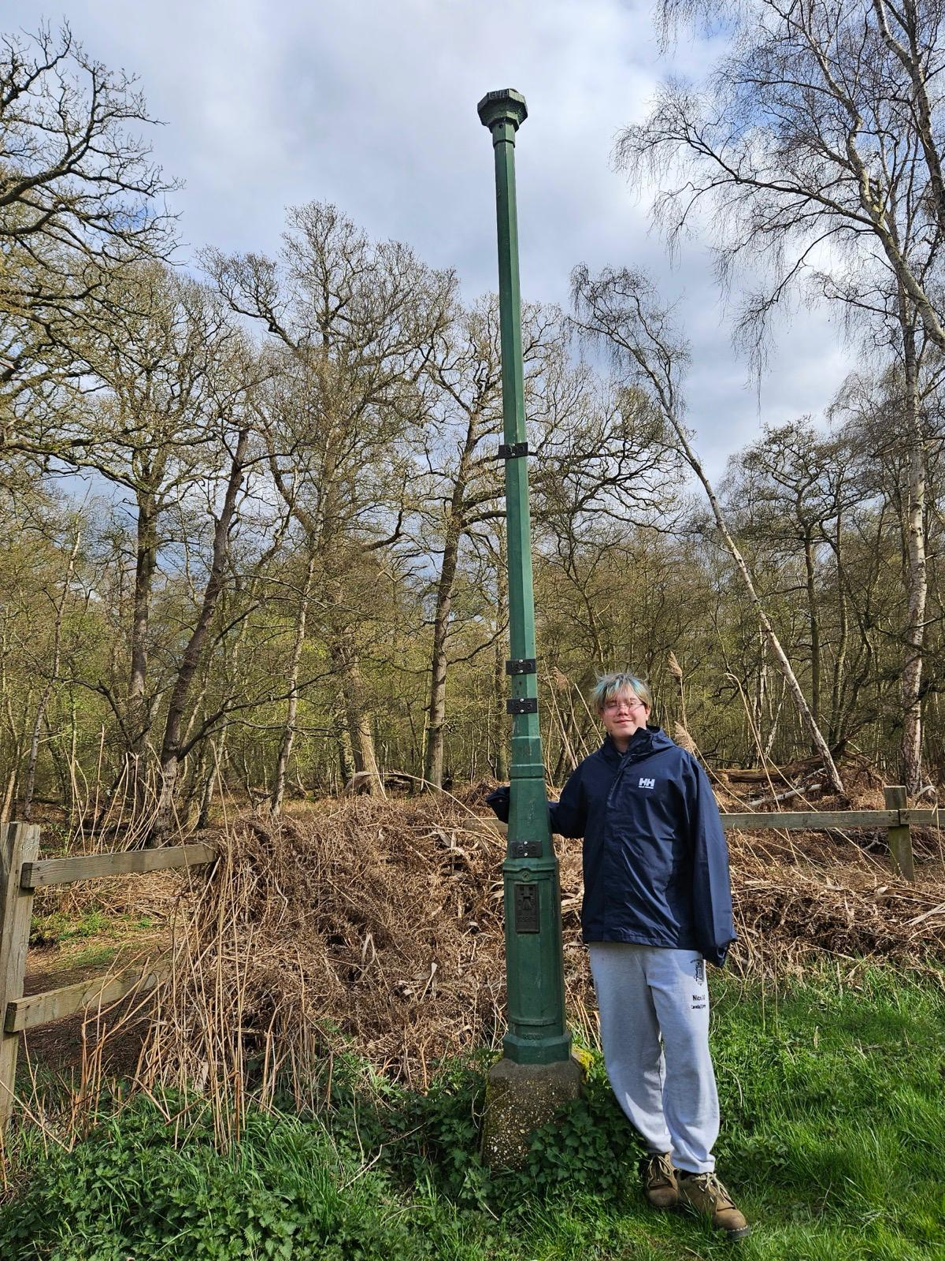

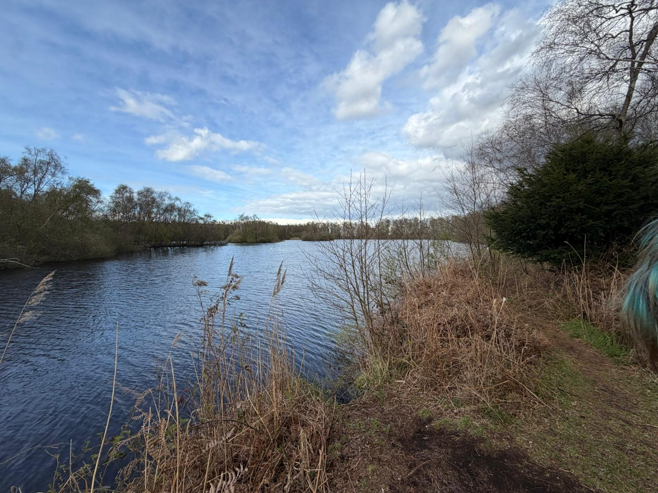

The sinking land
When peat dries out it shrinks and oxidises, lowering the land surface. At Holme Fen this subsidence has been measured for over 170 years.
How big is 4 metres?
The Holme Fen Post
More than TWO Adults
standing on each other's shoulders!
In 1848 an iron post was driven in until its top was level with the ground. The surface has since dropped roughly 4 metres, leaving the post standing well clear of the land.
≈ 4 m
DID YOU KNOW?
Holme Fen is now the lowest land point in Great Britain — about 2.75 m below sea level.
Notes:
Maths check you asked for: subsidence ≈4 m. An average adult man ≈1.75 m, so 4 ÷ 1.75 ≈ 2.3 — i.e. more than TWO 'Mr Deely's tall, not three (three would need him ~1.33 m). I've drawn ~2.3 people and phrased it as 'more than two grown-ups on each other's shoulders' to stay accurate. Swap in the real post photo you took.

Slide 7
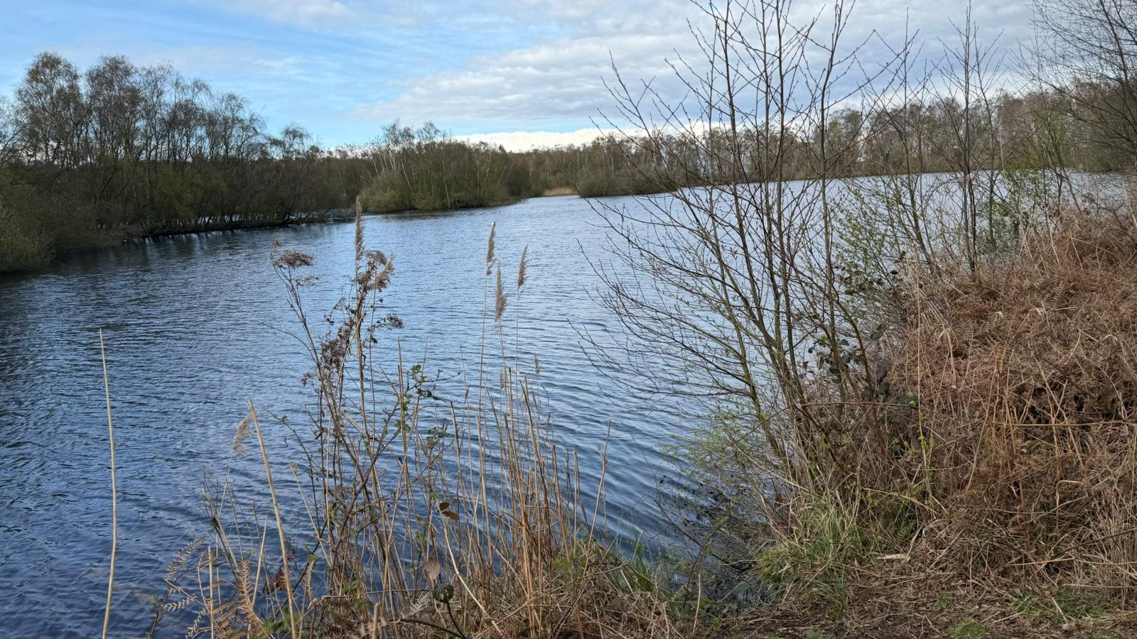



Why does it flood?
Because the land has sunk, many Fen rivers now sit HIGHER than the fields beside them.
When the rain pours…
River up here!
If a raised river overtops or an embankment is breached, water floods the low-lying land and homes below it.
Pump lifts water UP
DID YOU KNOW?
Pumps run almost constantly to lift water UP into the rivers — reversing the way water would naturally drain.
Low field
Low field
The land sank, but the rivers stayed up — held in by banks called embankments.
Notes:
Design refreshed with a real Fen photo background; cross-section content kept. Explain the perched rivers and pumps lifting water uphill.

Slide 8


Wetlands to the rescue!
Wetlands act like a sponge — storing storm water and releasing it slowly, which lowers and delays flood peaks.
Soaks it up
Slows it down
Protects homes
Homes for wildlife
Saturated ground and peat store large volumes of water.
Vegetation slows runoff so rivers rise more gradually.
Lower flood risk for towns, farmland and infrastructure.
Cleaner water and restored habitat for wildlife.
DID YOU KNOW?
A single hectare of healthy wetland (roughly a rugby pitch) can store millions of litres of water while supporting thousands of species — a low-cost, multi-benefit form of flood management.
Notes:
Colourful design over a lily-pad lake photo, emphasising wildlife and homes as you asked.

Slide 9
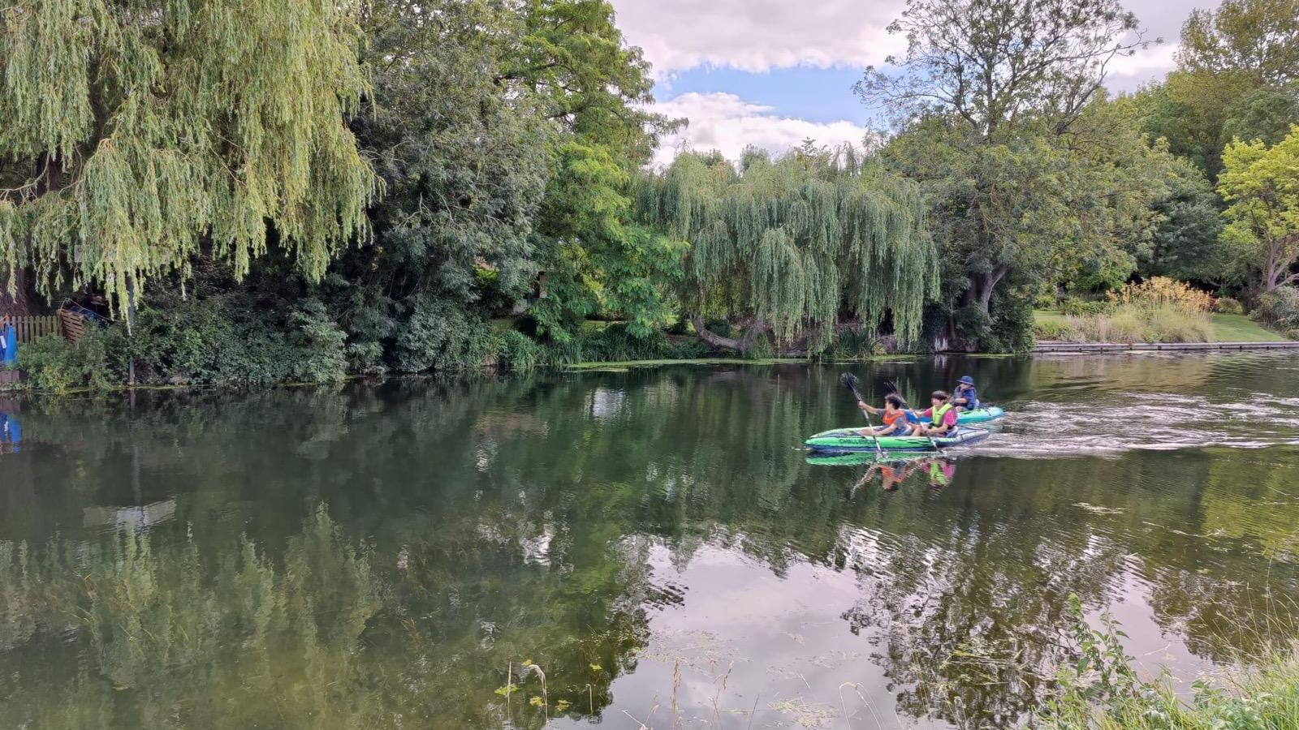
EDUCATION: OUR COMMITMENT TO SCHOOLS AND YOUTH LEARNING-BY-DOING
Restoring Our Fens: School Workshops
Age-adapted, Year 5 to Year 10
A special workshop of 90 – 120 mins designed for schools, covering water systems and wetlands, soft engineering, ‘green infrastructure’ and flood defence.
Piloted by King's College Primary School, Ixworth High School & beyond
Piloted and refined across King's College School, Ixworth High School and among youth from other Cambridgeshire schools
Built on systems thinking
Feedback loops, the iceberg model, and hands-on activities — including a pond web of life and a sponge experiment on flood absorption — bring abstract concepts to life.
A new curriculum opportunities
King's College School and other primary schools have invited us to help co-create and teach a new section of their biology syllabus on flood defence and wetlands.
Young people kayaking a restored fenlands river channel

Slide 10
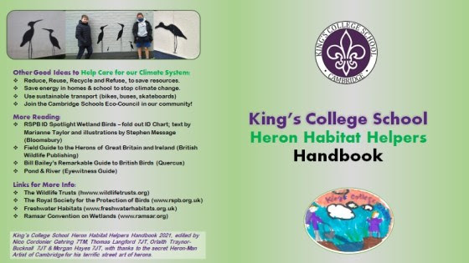
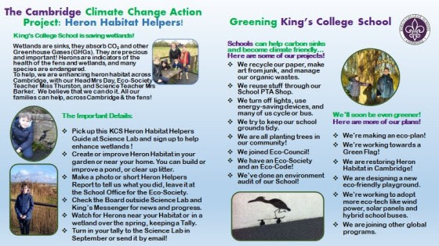
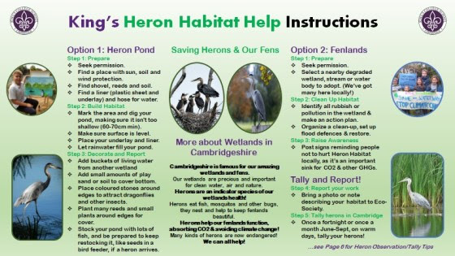
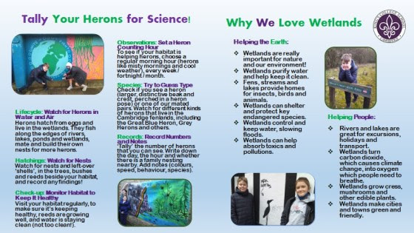
EDUCATION: OUR COMMITMENT TO SCHOOLS AND YOUTH LEARNING-BY-DOING
Our Heron Habitat Helpers Handbook
Can be specially tailored for each Primary School!
A hands-on companion to the primary schools workshops, developed with the Cambridge Schools Eco-Council, giving pupils practical ways to take action locally, building on what they just learned.
•
Ideas for schools: Pond-building, Fenland habitat activities to lead at school
•
Games and resources: Species-identification for local wetland wildlife
•
Tally Your Herons: Citizen-science recording sheet and exercises
•
Simple everyday actions: cutting plastic use, reducing food waste, choosing peat-free compost
Actual handbook, tailored for King's College School

Slide 11
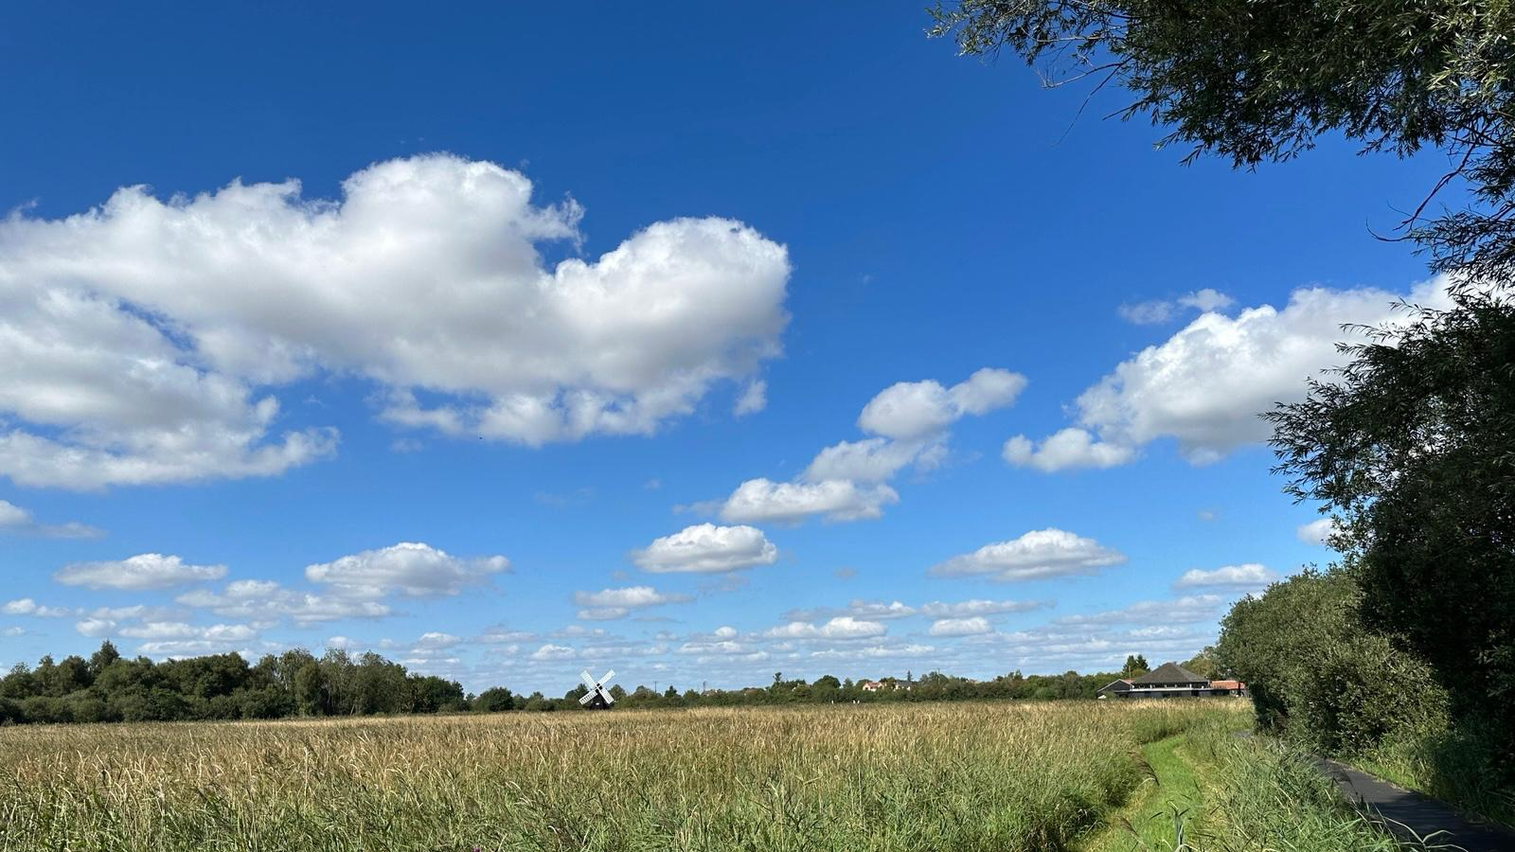
ENGAGEMENT: OUR IDEAS AND LOCAL / GLOBAL POLICY PROPOSALS
Wetlands City Accreditation
We propose Cambridge and Peterborough seek accreditation as a Ramsar Wetlands City — international recognition for cities that go beyond the minimum to protect their urban wetlands. We ran consultations, and found that…
Our region already qualifies…
•
Wicken Fen — Ramsar site since 1899, 10,000+ recorded species
•
The Nene Washes & Ouse Washes — internationally important flood-storage wetlands
•
The Wash — internationally important estuary for 17 bird species
We meet all six accreditation criteria…
According to our youth analysis, Cambridge / Peterborough can offer:
A qualifying Ramsar site • policy protection • active restoration • spatial planning • stakeholder participation • public awareness
74 cities in 27 countries hold this accreditation worldwide (2026) —
none yet in the East of England!

Slide 12
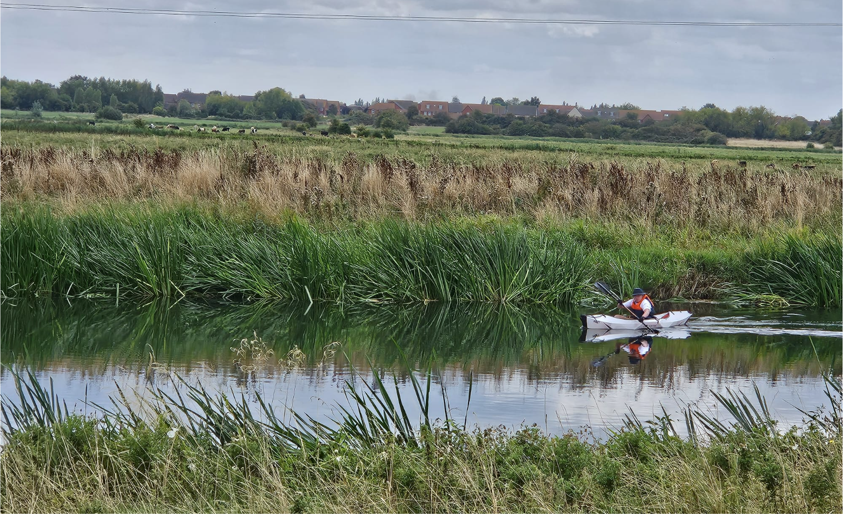
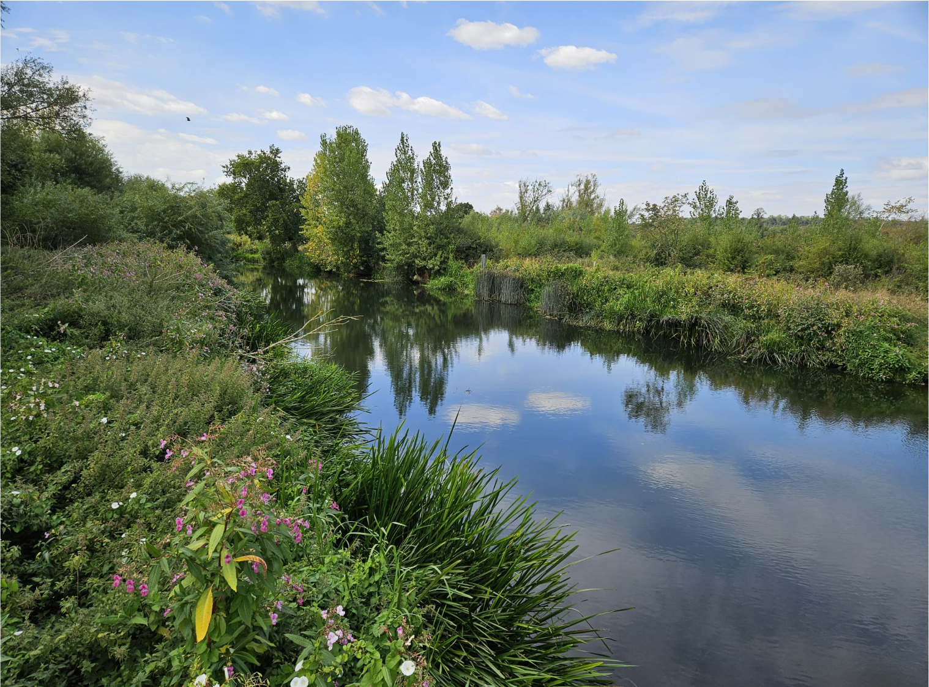
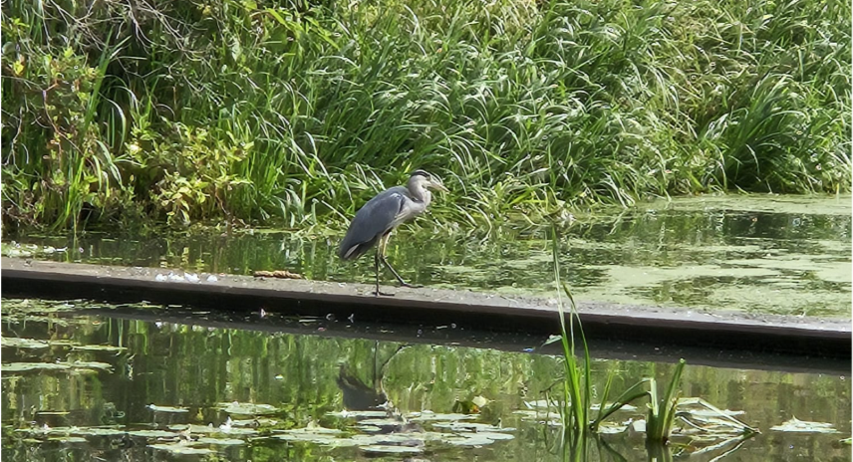
ENGAGEMENT: OUR IDEAS AND LOCAL / GLOBAL POLICY PROPOSALS
Harmony Journal: A Special Issue on SDG 6 Clean Water
Alongside our local consultations and policy work, we're editing the next global issue of our online youth journal Harmony on SDG 6 Clean Water told through the lens of the Fens for sharing at the United Nations!
Youth Insights, Evidence & Policy Ideas
Explainers connecting fen restoration to the Fens 2100+ programme and wider UK water policy, alongside stories and reviews comparing fenlands and local water perspectives with stories about wetlands and water systems worldwide.
Local & Global Youth Artwork & Action Features
Artwork and features on local action from Cambridgeshire students and beyond, covering their ideas for wetlands, flooding, and water quality improvements in their own local communities and their countries, and what they’re doing on the ground.
Youth Voices Heard Locally & Internationally
An invitation for young people everywhere to speak for wetlands not as wasteland, but as vital water green and blue infrastructure, online in the United Nations High Level Political Forum on Sustainable Development (July 2026), the Convention on Biological Diversity (Oct 2026), at the Rights of the River Festival (June 2026) and Cambridge Zero Community Day (July 2026).

Slide 13
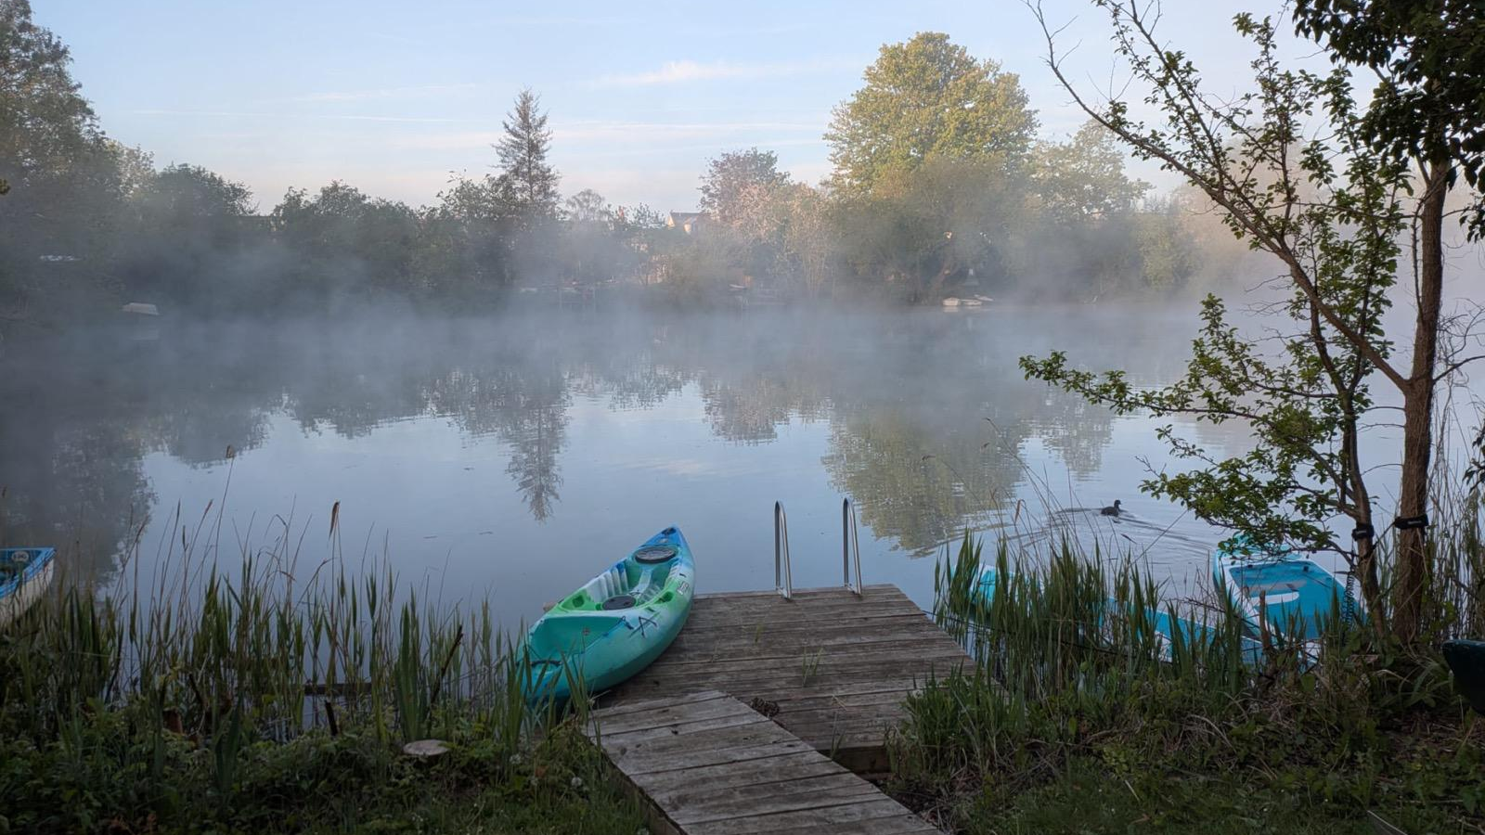
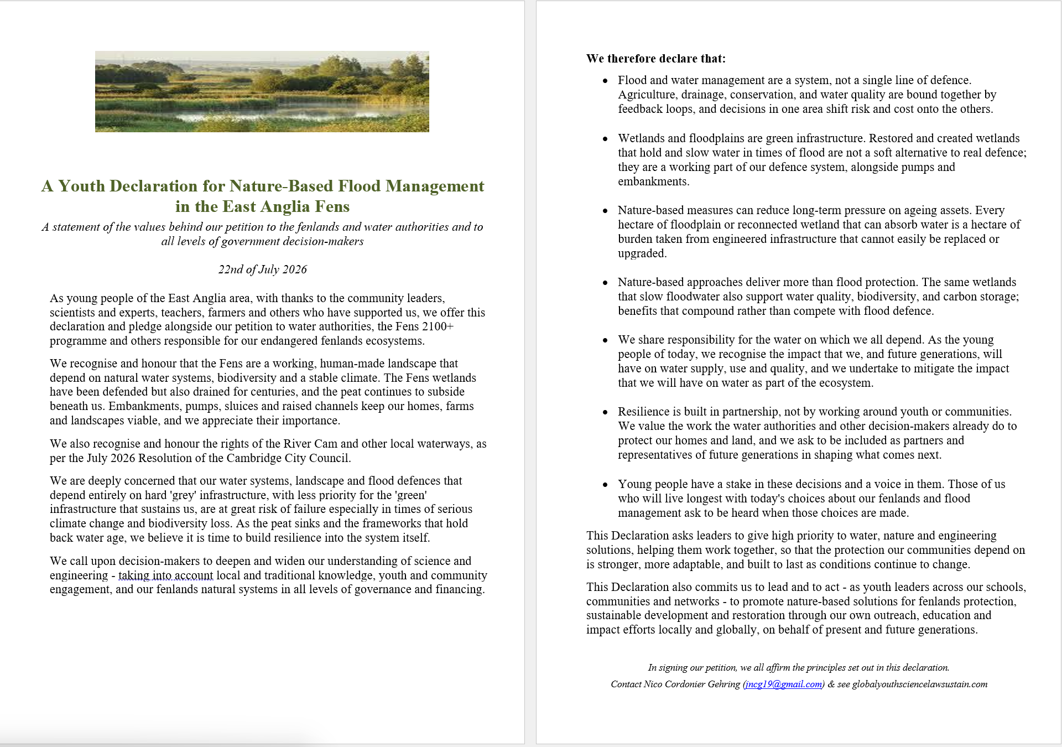
EMERGENCY IMPACT: OUR FUTURE GENERATIONS DECLARATION AND PETITION
A Youth Declaration for the Future of Our Fens
A Call from the youth of the Fens, as voices of future generations. In partnership with all who share this water system and landscape, and in full support of the Rights of the River Cam, its chalk streams and connected waterways…
Space
Life
A voice
Dawn on a Cambridge Fenland lake

Slide 14
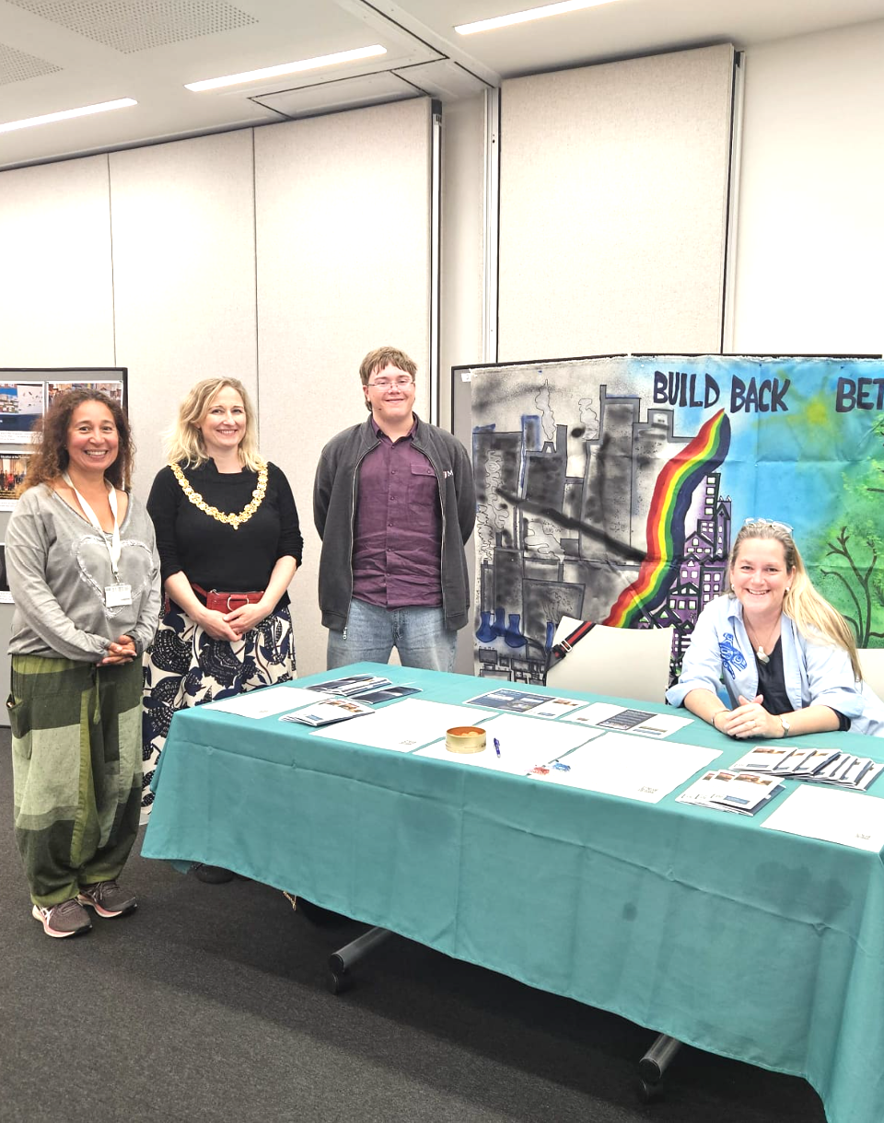
EMERGENCY IMPACT: OUR FUTURE GENERATIONS DECLARATION AND PETITION
A Petition to the Authorities
We ask the water authorities, the Fens 2100+ programme and other decision-makers to give greater weight to soft-engineering and nature-based approaches — alongside, not instead of, existing infrastructure. Specifically, we ask them to:
•
Restore and create wetlands in suitable locations
•
Adopt soft-engineering alongside hard infrastructure
•
Promote wetland habitats as part of the flood-defence system
•
Reduce long-term pressure on ageing engineered assets
•
Listen to the community — including young people
We make this request in a spirit of partnership, valuing all our policy leaders and decision-makers’ work while asking for this aspect to be prioritized, strengthened and financed.
Cambridge Zero Community Day Petition

Slide 15
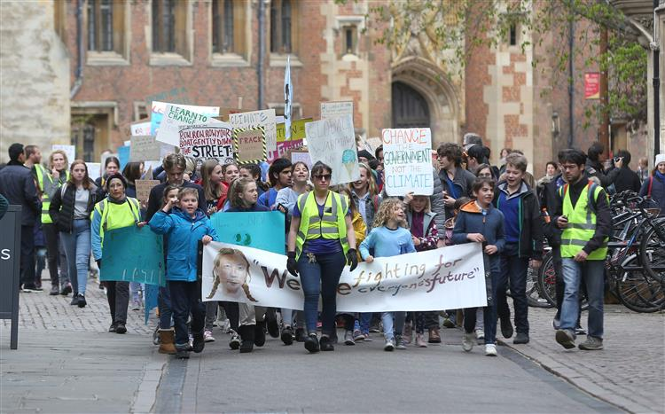
OVER TO YOU — 1:45 TO 2:15PM
Questions for Policy Leaders, Experts & Community
Where do you already see political or legal openings for fen restoration to be taken seriously as flood infrastructure?
What would it take for wetland restoration to compete with concrete defences when funding decisions are made?
Farming, water quality, development and flood risk pull in different directions — who should resolve that, and at what level?
What's the single biggest legal or regulatory obstacle to large-scale fen restoration right now?
What would make our declaration and petition genuinely useful to you?
Could the River Cam's recent rights recognition help our case?
Beyond today, what would lasting partnership between youth and policy leaders actually look like?

