Slide 1
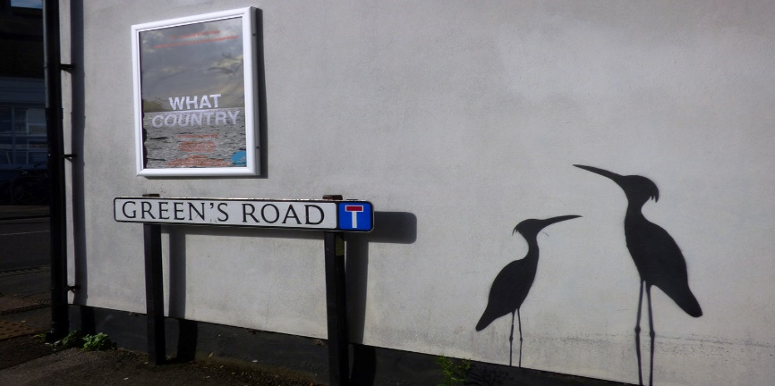
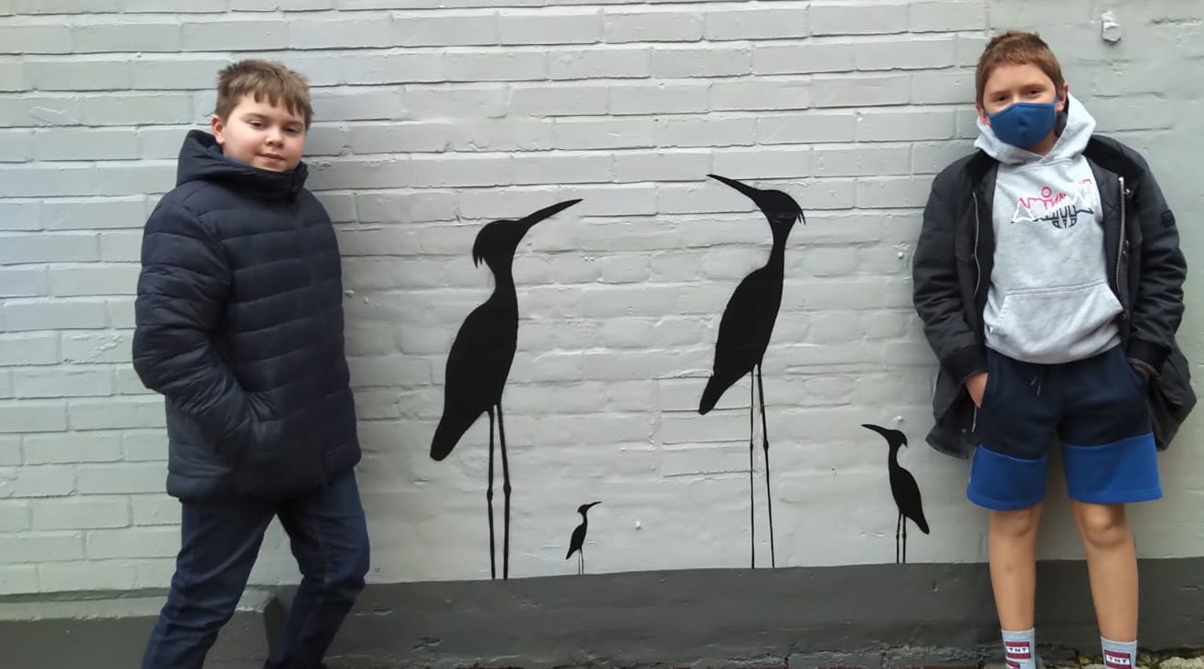
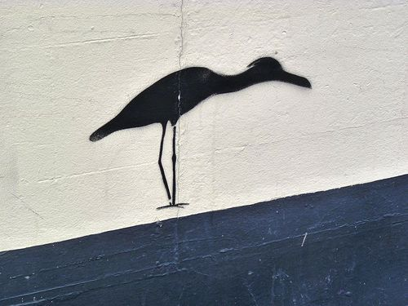
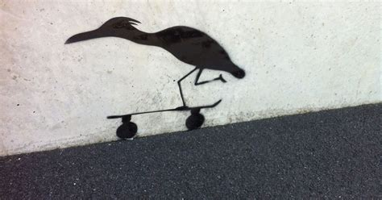
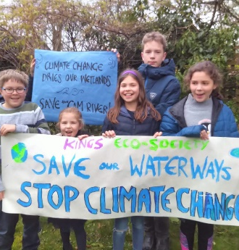
Schools
Heron Habitat Helpers
Handbook
Other Good Ideas to Help Care for our Climate System:
Reduce, Reuse, Recycle and Refuse, to save resources.
Save energy in homes & school to stop climate change.
Use sustainable transport (bikes, buses, skateboards)
Join the Cambridge Schools Eco-Council in our community!
More Reading:
RSPB ID Spotlight Wetland Birds – fold out ID Chart; text by Marianne Taylor and illustrations by Stephen Message (Bloomsbury)
Field Guide to the Herons of Great Britain and Ireland (British Wildlife Publishing)
Bill Bailey’s Remarkable Guide to British Birds (Quercus)
Pond & River (Eyewitness Guide)
Links for More Info:
The Wildlife Trusts (hwww.wildlifetrusts.org)
The Royal Society for the Protection of Birds (www.rspb.org.uk)
Freshwater Habitats (www.freshwaterhabitats.org.uk)
Ramsar Convention on Wetlands (www.ramsar.org)
Heron Habitat Helpers Handbook 2021, edited by Nico, Thomas, Orlaith & Morgan , with thanks to the secret Heron-Man Artist of Cambridge for his terrific street art of herons.

Slide 2
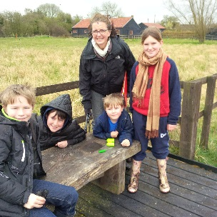
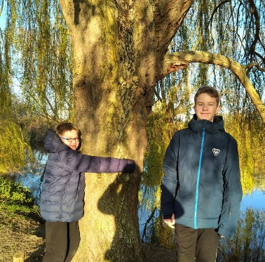
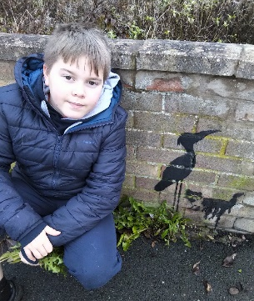
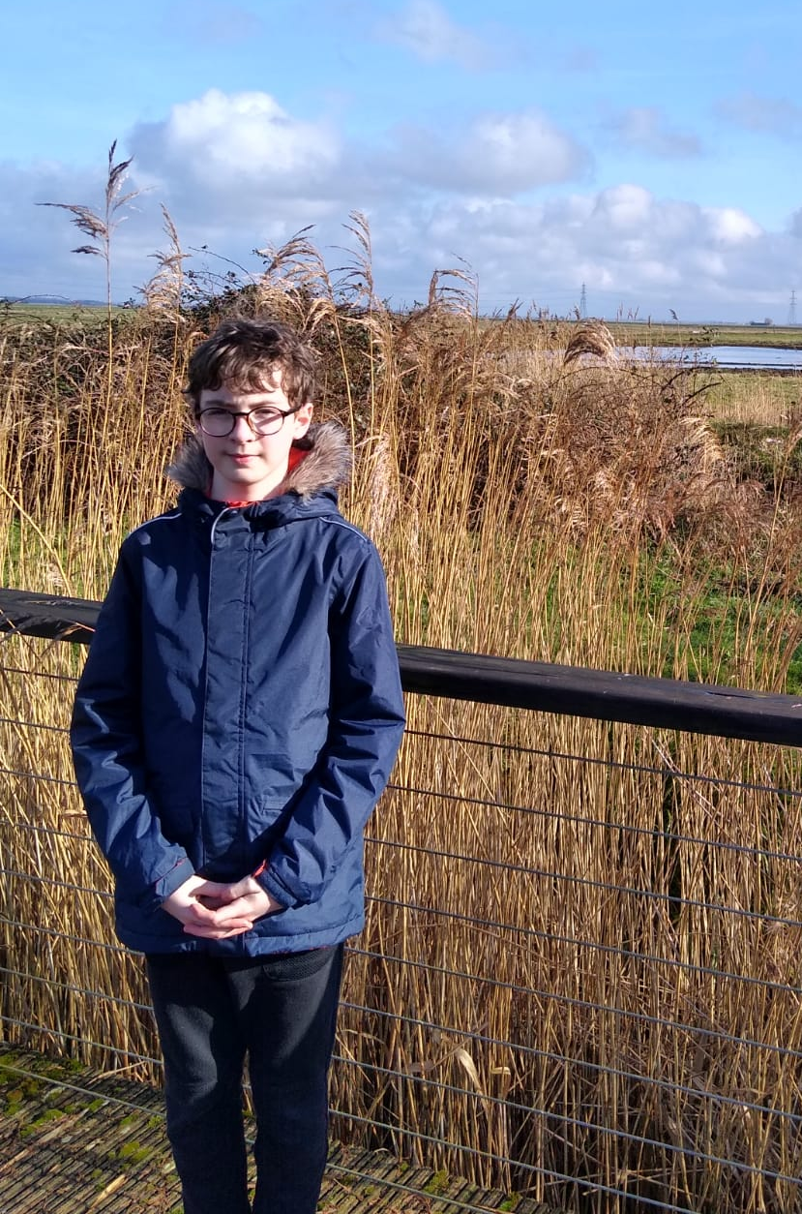
Greening Fenlands Schools
The Cambridge Climate Change Action Project: Heron Habitat Helpers!
School are saving wetlands!
Wetlands are sinks, they absorb CO₂ and other Greenhouse Gases (GHGs). They are precious and important! Herons are indicators of the
health of the fens and wetlands, and many species are endangered.
To help, we are enhancing heron habitat across Cambridge, engaging our Heads, Science Teachers, Careers Programmes and communities. We believe that we can do it. All our families can help, across Cambridgeshire & the fens!
Schools can help carbon sinks and become climate friendly…
Some project ideas include:
We can recycle our paper, make art from junk, and manage our organic wastes.
We can reuse stuff through our School PTA Shop.
We can turn off lights, use energy-saving devices, and many of us cycle or bus.
We can try to keep our school grounds tidy.
We can all plant trees in our community!
We can create an Eco-Society and an Eco-Code!
We can do an environment audit of our School!
The Important Details:
Pick up this Heron Habitat Helpers Guide at Science Lab and sign up to help enhance wetlands !
Create or improve Heron Habitat in your garden or near your home. You can build or improve a pond, or clear up litter.
Make a photo or short Heron Helpers Report to tell us what you did, leave it at the School Office.
Check the Board outside Science Lab and school bulletins for news and progress.
Watch for Herons near your Habitat or in a wetland over the spring, keeping a Tally.
Turn in your tally to the Science Lab in September or send it by email!
We’ll soon be even greener!
Here are stretch targets!
We can make an eco-plan!
We can work towards a Green Flag!
We can restore Heron Habitat in Cambridge!
We can design a more eco-friendly playground.
We can work to adopt more eco-tech like wind power, solar panels and hybrid school buses.
We can join other global programmes.

Slide 3
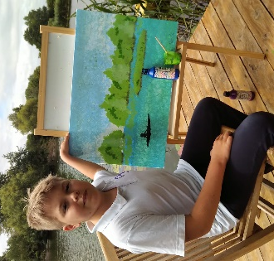
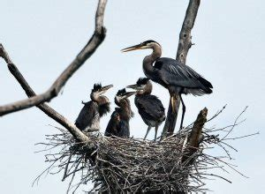
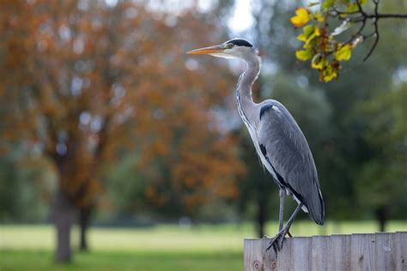
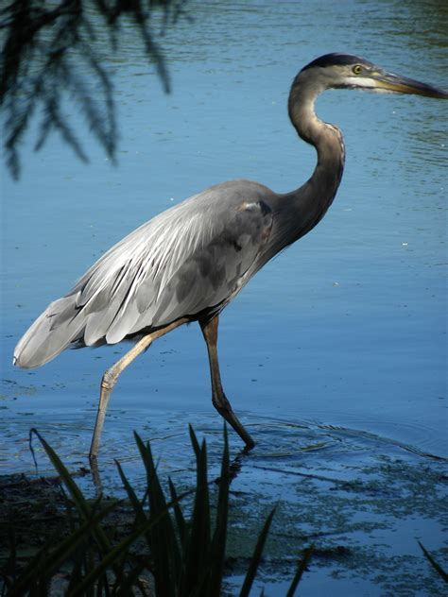
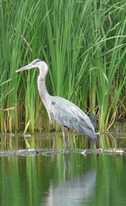
Heron Habitat Help Instructions
Option 1: Heron Pond
Step 1: Prepare
Seek permission.
Find a place with sun, soil and wind protection.
Find shovel, reeds and soil.
Find a liner (plastic sheet and underlay) and hose for water.
Step 2: Build Habitat
Mark the area and dig your pond, making sure it isn't too shallow (60-70cm min).
Make sure surface is level.
Place your underlay and liner.
Let rainwater fill your pond.
Step 3: Decorate and Report
Add buckets of living water from another wetland
Add small amounts of play sand or soil to cover bottom.
Place coloured stones around edges to attract dragonflies and other insects.
Plant many reeds and small plants around edges for cover.
Stock your pond with lots of fish, and be prepared to keep restocking it, like seeds in a bird feeder, if a heron arrives.
Saving Herons & Our Fens
Option 2: Fenlands
Step 1: Prepare
Seek permission.
Select a nearby degraded wetland, stream or water body to adopt. (We’ve got many here locally!)
Step 2: Clean Up Habitat
Identify all rubbish or pollution in the wetland & make an action plan.
Organize a clean-up, set up flood defences & restore.
Step 3: Raise Awareness
Post signs reminding people not to hurt Heron Habitat locally, as it’s an important sink for CO2 & other GHGs.
More about Wetlands in Cambridgeshire
Cambridgeshire is famous for our amazing wetlands and fens.
Our wetlands are precious and important for clean water, air and nature.
Herons are an indicator species of our wetlands health!
Herons eat fish, mosquitos and other bugs, they nest and help to keep fenlands beautiful.
Herons help our fenlands function, absorbing CO2 & avoiding climate change!
Many kinds of herons are now endangered!
We can all help!
Tally and Report!
Step 4: Report your work
Bring a photo or note describing your habitat to Eco-Society.
Step 5: Tally herons in Cambridge
Once a fortnight or once a month June-Sept, on warm days, tally your herons!
…see Page 6 for Heron Observation/Tally Tips

Slide 4
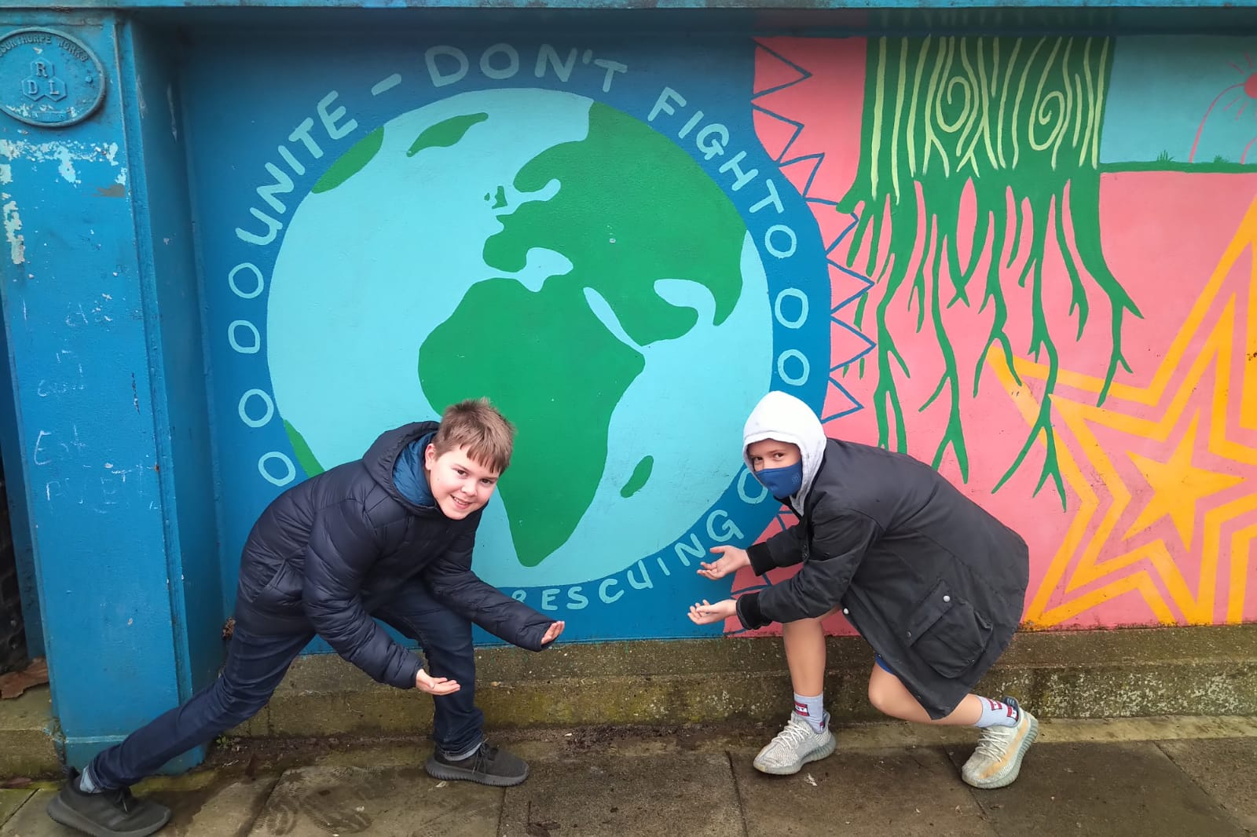
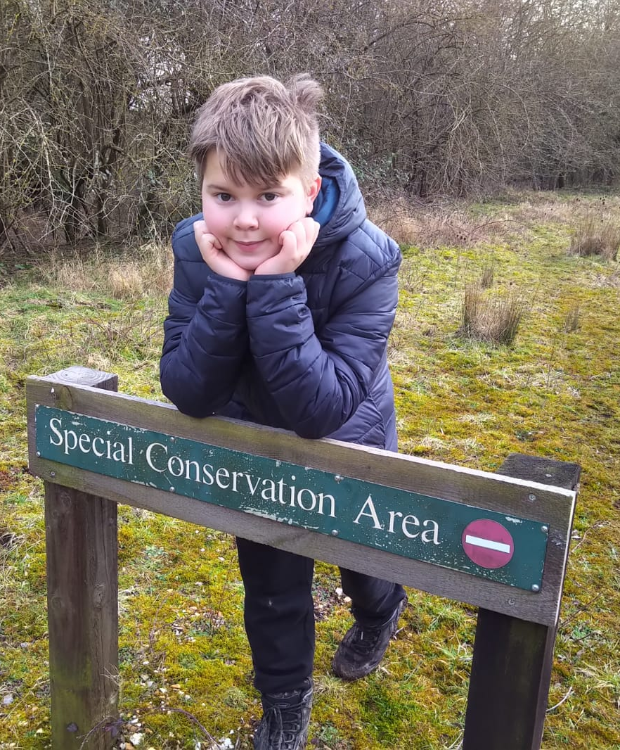
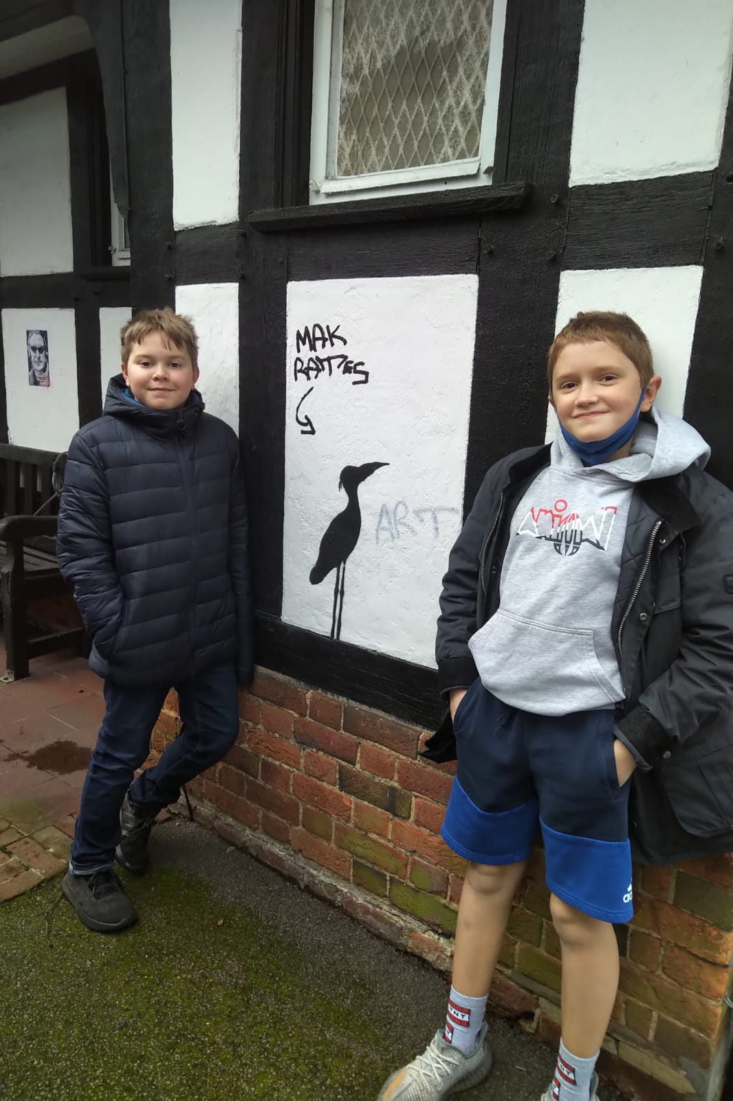
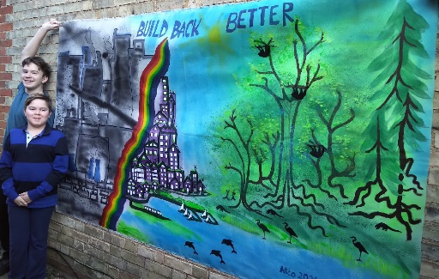
Why We Love Wetlands
Tally Your Herons for Science!
Observations: Set a Heron Counting Hour
To see if your habitat is helping herons, choose a regular morning hour (herons like misty mornings and cool weather), every week / fortnight / month.
Species: Try to Guess Type
Check if you see a heron (larger, distinctive beak and crest, perched in a heron pose) or one of our mated pairs. Watch for different kinds of herons that live in the Cambridge fenlands, including the Great Blue Heron, Grey Herons and others.
Records: Record Numbers and Notes
‘Tally’ the number of herons that you can see. Write down the day, the hour and whether there is a family nesting nearby. Add notes (colours, speed, behaviour, species).
Helping the Earth:
Wetlands are really important for nature and our environment!
Wetlands purify water and help keep it clean.
Fens, streams and lakes provide homes for insects, birds and animals.
Wetlands can shelter and protect key endangered species.
Wetlands control and keep water, slowing floods.
Wetlands can help absorb toxics and pollutions.
Lifecycle: Watch for Herons in Water and Air
Herons hatch from eggs and live in the wetlands. They fish along the edges of rivers, lakes, ponds and wetlands, mate and build their own nests for more herons.
Hatchings: Watch for Nests
Watch for nests and left-over ‘shells’, in the trees, bushes and reeds beside your habitat, and record any findings!
Check-up: Monitor Habitat to Keep It Healthy
Visit your habitat regularly, to make sure it’s keeping healthy, reeds are growing well, and water is staying clean (not too clean!).
Helping People:
Rivers and lakes are great for excursions, holidays and transport.
Wetlands turn carbon dioxide, which causes climate change, into oxygen which people need to breathe.
Wetlands grow cress, mushrooms and other edible plants.
Wetlands make cities and towns green and friendly.

