Slide 1
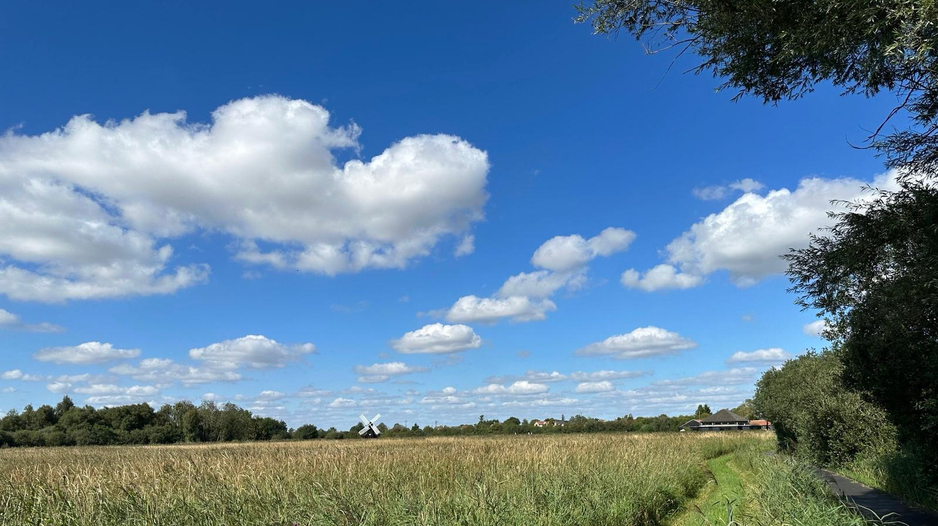
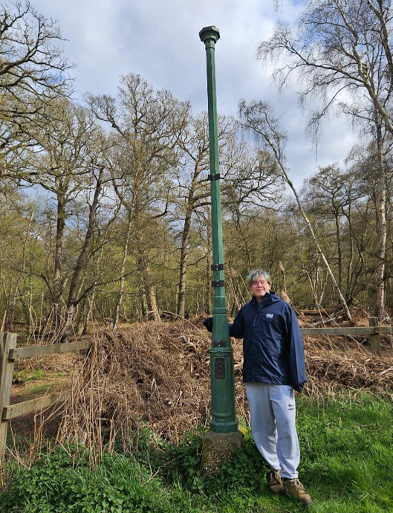

Fenlands Restoration as Flood Defence & Water Quality
Wednesday 22 July 2026
1:00 – 2:30pm
In Meeting Room 2 at the Guildhall and Online
Add a photo of Nico here
Notes:
Title: 'Restoring Our Fens'. Background is a real Fenland photo (windmill & reedbed). Introduce yourself: name, that you're at UWC Atlantic, Vice-Chair of GYC, and a KCS alumnus — this builds a friendly bridge with the pupils. Swap the placeholder for your own photo.

Slide 2




Today we look at the Fenlands as a living system — and how restoring them could help manage flooding.
Think in systems
Explore wetlands
Restore the Fens
How the parts of an ecosystem connect and influence each other.
What wetlands are, and why they support so much life.
How restoring wetlands can reduce flood risk and store carbon.
DID YOU KNOW?
The Fens are one of the largest areas of low-lying land in Britain, and much of the surface now sits below sea level. Without constant drainage and pumping, a lot of it would flood.
Notes:
'Restore' is the key new verb — we're not just learning, we're healing the landscape. Fresh green Fen background. Ask who has seen a very wet field or a flood.

Slide 3
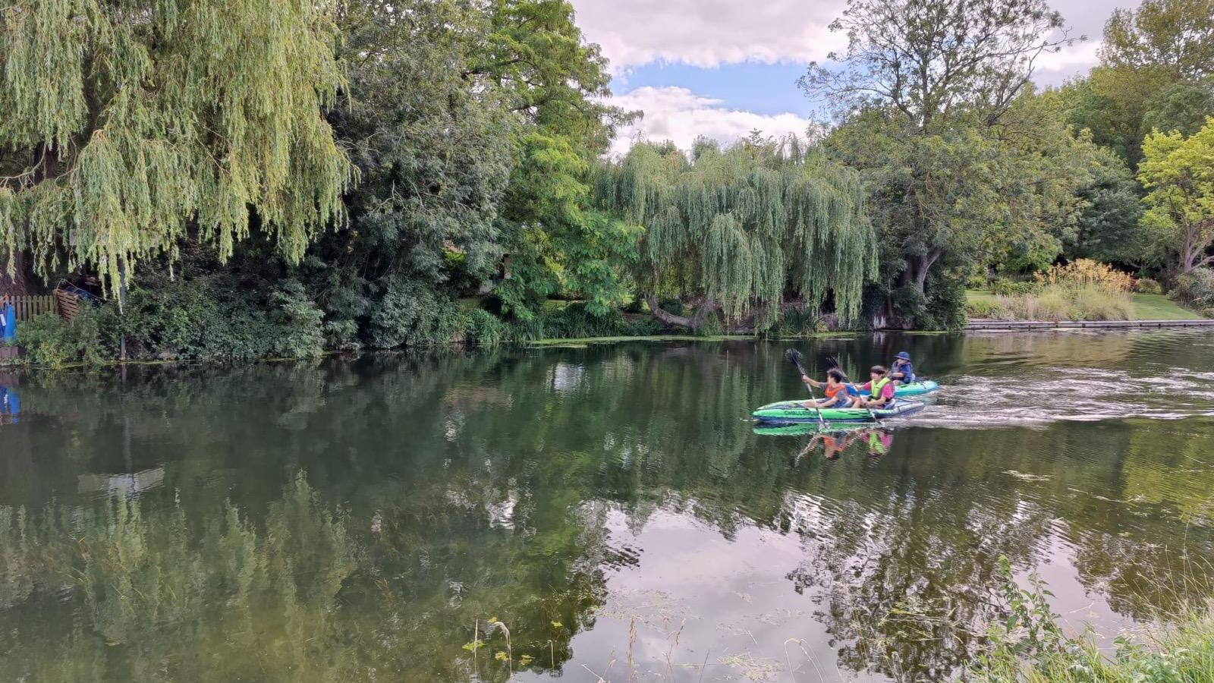
PART 1
Thinking in Systems
A powerful way to understand how nature works
Willows, water and wildlife on a Cambridgeshire lake
Notes:
Divider for Part 1. The photo shows children kayaking by willows — a living green wetland with people enjoying it. If you have a photo of Kings/Cambridge or otters/swans, this is a good slide to swap it in.

Slide 4


Everything is connected
A system is a set of parts that interact and depend on one another — think of a spider's web.
…the whole web shakes
Change one part of a system, and the effects ripple out to every other part.
Ecosystems are vast, interconnected webs. In a pond, a wetland, or the whole Fens, a change to one element shifts everything linked to it — often in ways that aren't obvious at first.
Pull one thread…
Notes:
Spider-web metaphor ONLY (other examples removed). Get a pupil to mime pulling a thread and watch the whole web shake. Land the idea that nature is a giant connected web — this sets up the pond-drawing activity next.

Slide 5

ACTIVITY
Map a pond as a system
Think like a systems scientist: map how the living and non-living parts of a pond depend on each other.
The task
Apply the thinking
1
Sketch a pond in the centre of your page.
2
Add the key components — fish, amphibians, insects, reeds, birds, and the water itself.
What happens to the whole system if the pond dries up?
That's the same question systems scientists ask about the real Fens.
3
Draw arrows to show the relationships and dependencies between them.
4
Map the food chains and flows: who consumes what, and which parts rely on the water and plants?
Notes:
Hands-on drawing activity (replaces abstract examples). Hand out paper. Let them draw a pond, add living things, then arrows for connections. Circulate and prompt 'who needs who?'. Next slide shows your model answer and praises their work.

Slide 6






Reviewing your system maps
Here's one version — but there's no single right answer, and a more detailed map is often a better one.
Heron
The takeaway
Frog
Fish
POND
Every connection you mapped reflects a real principle: in an ecosystem, nothing exists in isolation. This is exactly how systems scientists analyse the natural world.
Reeds
Insects
Add your name, age and school on the back — selected work may be published online by GYC (with permission).
Notes:
Show YOUR model pond web and warmly praise their drawings — find specific good ideas in the room. Note the footer: name/age/school on the back, may be published online by GYC (get the usual permissions). Keep the praise genuine and specific.

Slide 7
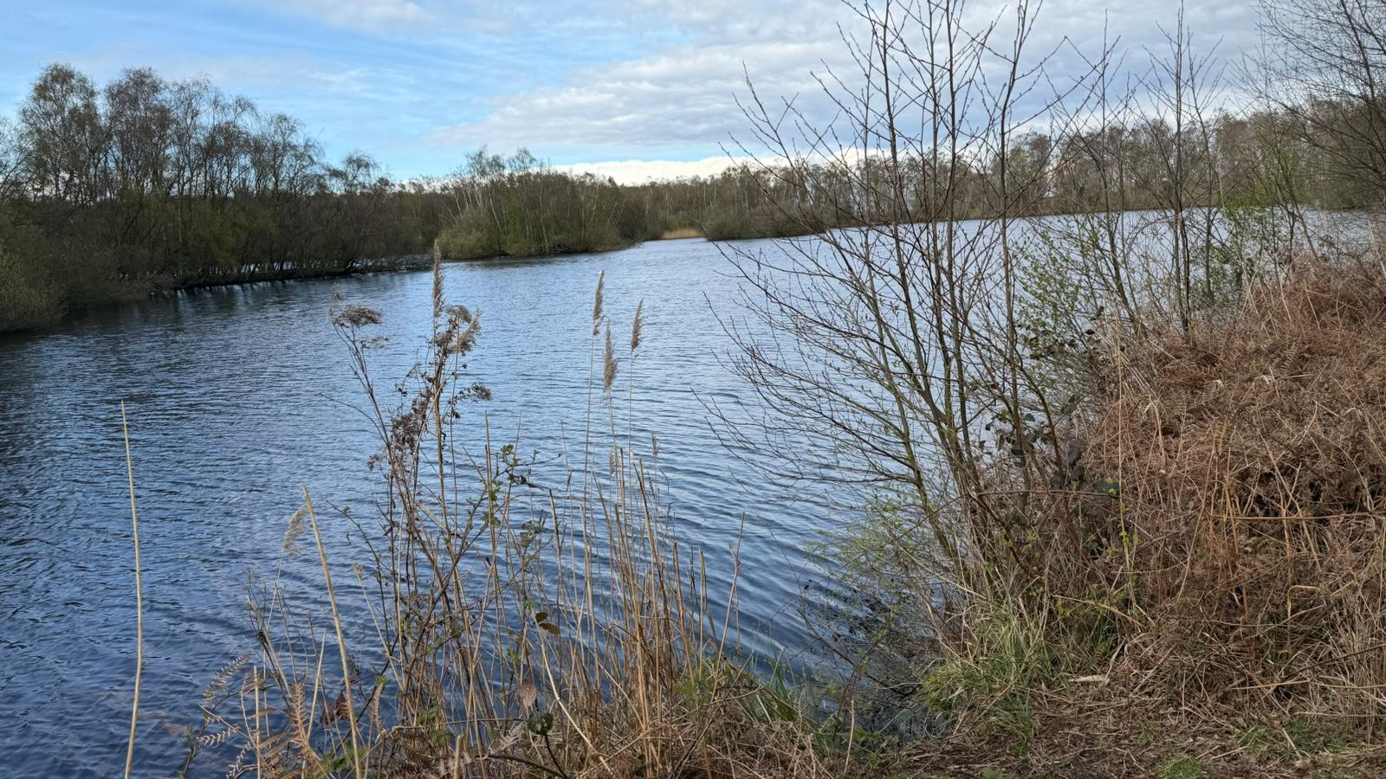


A reinforcing feedback loop
Sometimes a change feeds back on itself, making the original problem worse over time.
We drain
More water
Soil sinks
Draining dries the peat → the peat shrinks and the land sinks → more water must be pumped out → so drainage intensifies. The loop reinforces itself.
Notes:
Feedback loop over a real Fen lake photo. Walk the loop with a finger. This vicious cycle is why the problem is tricky — and why restoring wetlands breaks the loop.

Slide 8
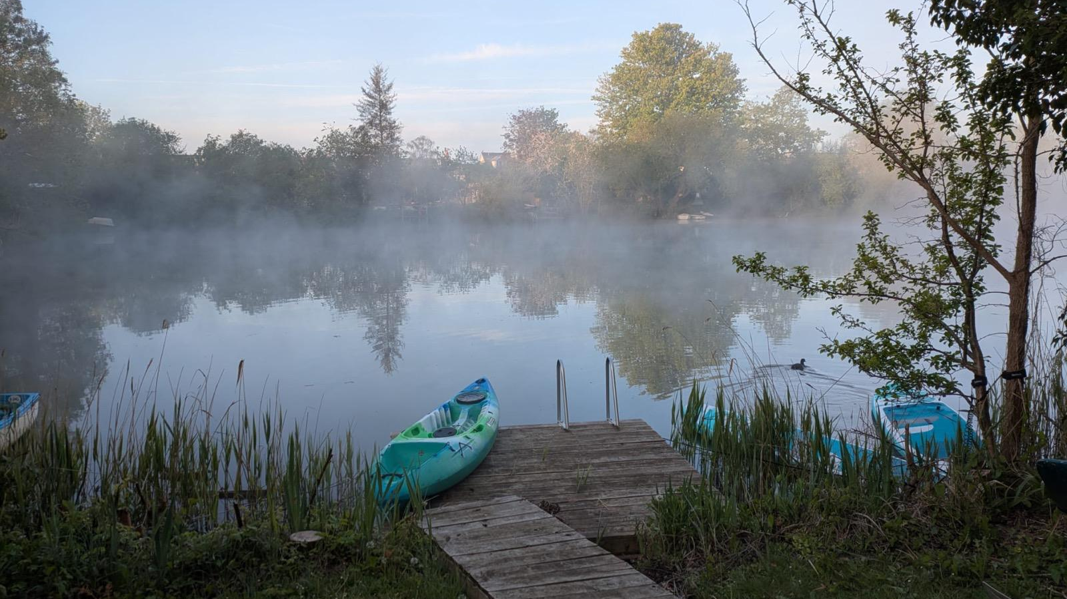
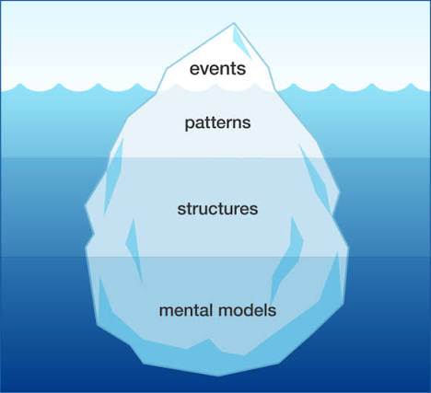
Look under the surface
A flood is the visible event. A systems thinker looks past it to ask what underlying conditions and decisions produced it.
What we SEE: A field has flooded
Underneath: It rained a lot and rivers are high
Deeper: Wetlands were drained — water has nowhere to go
Deepest: Long ago we chose farmland over wet land
Looking beneath the visible event to the patterns, structures and decisions driving it is known as the ICEBERG MODEL.
Notes:
Reframed as you asked: lead with 'what we see in a flood vs the underlying factors', THEN name it an iceberg diagram at the end. Misty dawn photo suits the 'hidden depths' idea. Encourage 'why?' questions to dig down the layers.

Slide 9
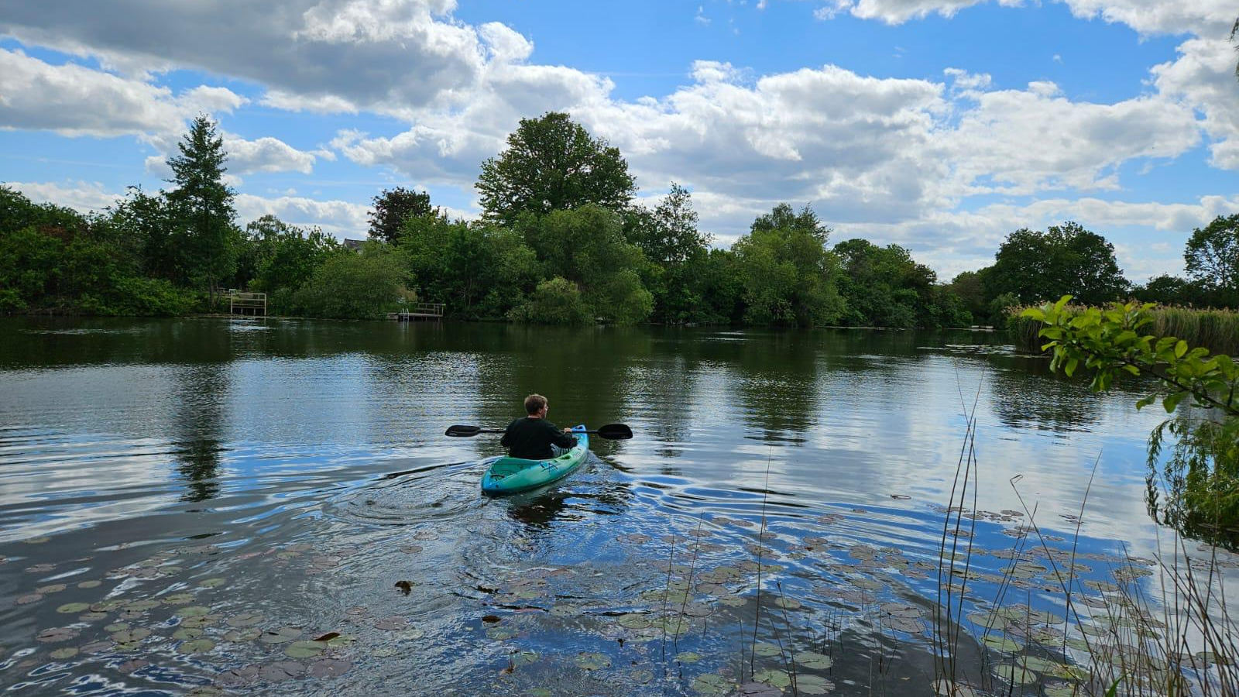
PART 2
Wetlands & the Fens
How wetlands reduce flood risk
Notes:
Divider for Part 2 over a lily-pad lake photo.

Slide 10
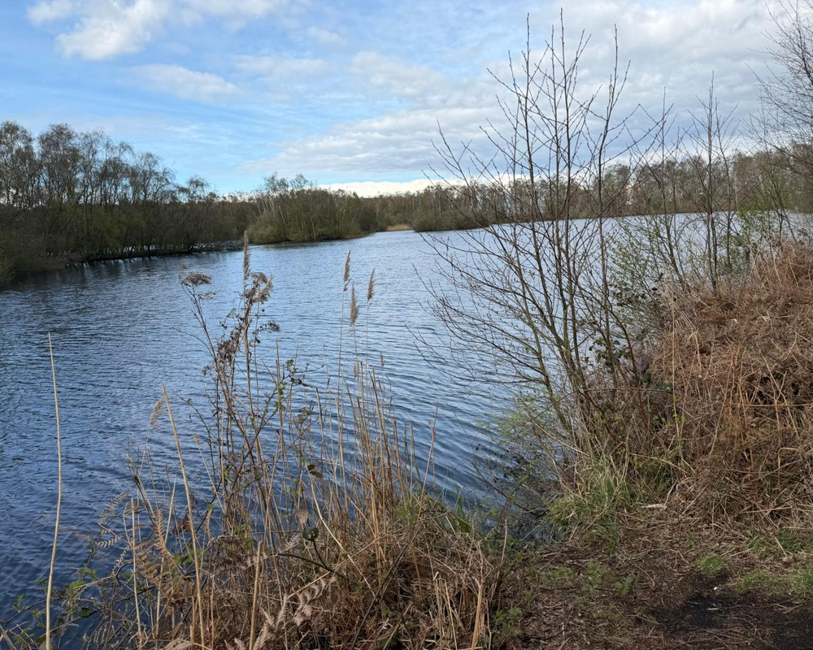



What is a wetland?
Land saturated with water for much of the year — a transition between land and open water, and one of the most biodiverse habitats there is.
Always soggy
Reeds & rushes
Acts like a natural sponge, storing water.
Water-tolerant plants that slow and filter flow.
Bursting with life
Cleans water
Rich biodiversity — birds, amphibians, fish and invertebrates.
Vegetation traps sediment and removes pollutants.
A real Fenland wetland
Notes:
Lovely content kept, design swapped to use a real wetland photo panel. Wicken Fen is the nearby living example if pupils have visited.

Slide 11


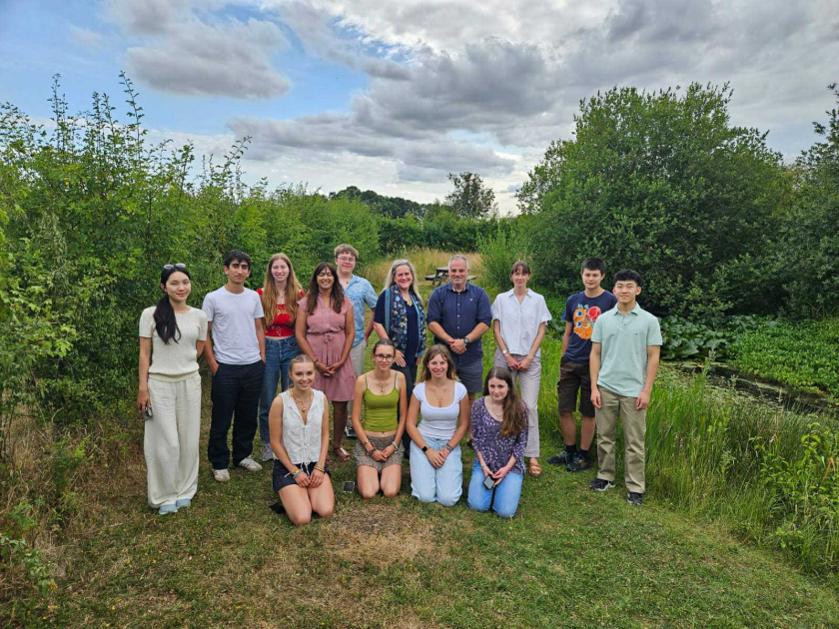

The story of the Fens
The landscape around Cambridge has been transformed by people — it was not always farmland.
Long ago
People drain it
Rich farmland
The catch
A vast natural wetland of water, reedbeds and wildlife.
From the 1600s, engineered ditches and pumps drained the water for agriculture.
The drained peat became highly fertile, productive farmland.
But exposed peat shrinks and oxidises, so the land sank below the rivers.
Over to you: can you name a very OLD settlement in the Fens, and a much NEW one? (For example Ely, Wicken or Whittlesea — versus a recent development.)
Add photos: Holme Fen, Wicken Fen, River Cam, Ouse, Nene
Notes:
Story kept (terrific content). Added: a place-name quiz to involve them (old vs new place in the Fens), and a photo strip placeholder for Holme Fen, Wicken Fen, and the Cam/Ouse/Nene rivers — drop those in when you have them.

Slide 12
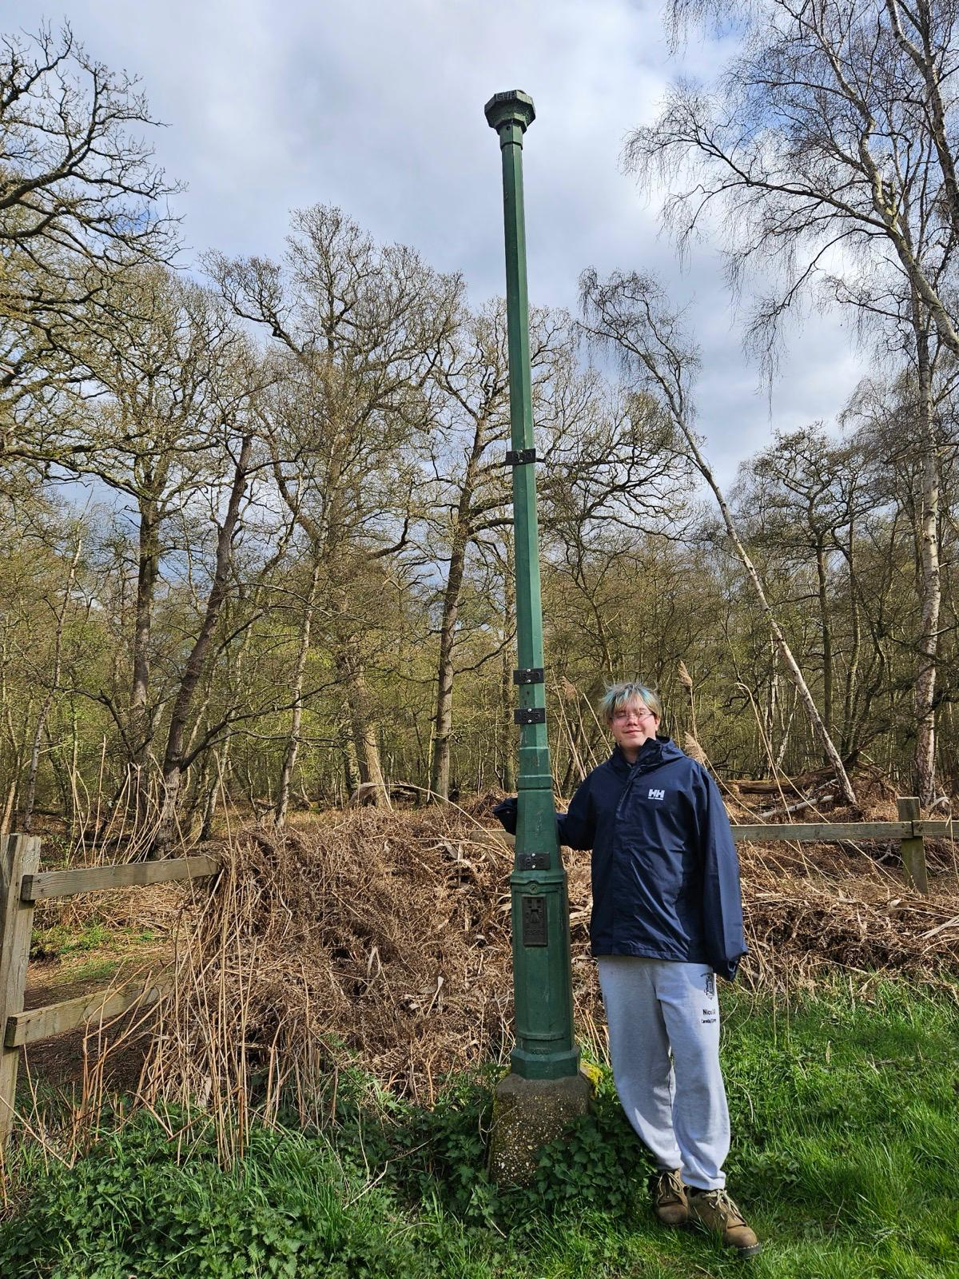

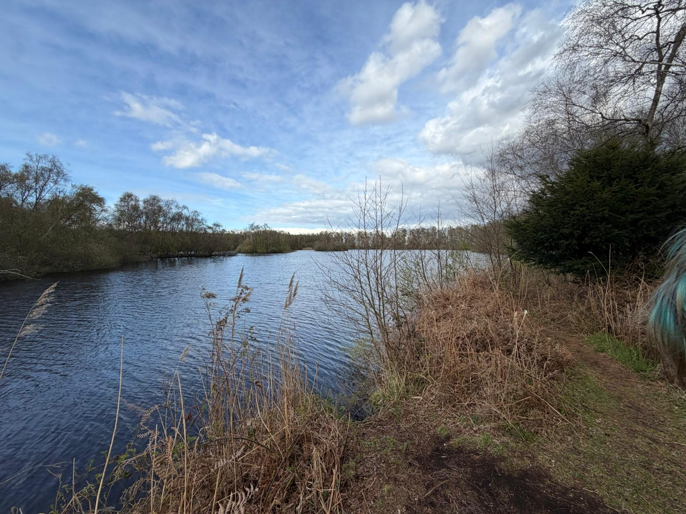
The sinking land
When peat dries out it shrinks and oxidises, lowering the land surface. At Holme Fen this subsidence has been measured for over 170 years.
How big is 4 metres?
The Holme Fen Post
More than TWO Adults
standing on each other's shoulders!
In 1848 an iron post was driven in until its top was level with the ground. The surface has since dropped roughly 4 metres, leaving the post standing well clear of the land.
≈ 4 m
DID YOU KNOW?
Holme Fen is now the lowest land point in Great Britain — about 2.75 m below sea level.
Notes:
Maths check you asked for: subsidence ≈4 m. An average adult man ≈1.75 m, so 4 ÷ 1.75 ≈ 2.3 — i.e. more than TWO 'Mr Deely's tall, not three (three would need him ~1.33 m). I've drawn ~2.3 people and phrased it as 'more than two grown-ups on each other's shoulders' to stay accurate. Swap in the real post photo you took.

Slide 13



Why does it flood?
Because the land has sunk, many Fen rivers now sit HIGHER than the fields beside them.
When the rain pours…
River up here!
If a raised river overtops or an embankment is breached, water floods the low-lying land and homes below it.
Pump lifts water UP
DID YOU KNOW?
Pumps run almost constantly to lift water UP into the rivers — reversing the way water would naturally drain.
Low field
Low field
The land sank, but the rivers stayed up — held in by banks called embankments.
Notes:
Design refreshed with a real Fen photo background; cross-section content kept. Explain the perched rivers and pumps lifting water uphill.

Slide 14


Wetlands to the rescue!
Wetlands act like a sponge — storing storm water and releasing it slowly, which lowers and delays flood peaks.
Soaks it up
Slows it down
Protects homes
Homes for wildlife
Saturated ground and peat store large volumes of water.
Vegetation slows runoff so rivers rise more gradually.
Lower flood risk for towns, farmland and infrastructure.
Cleaner water and restored habitat for wildlife.
DID YOU KNOW?
A single hectare of healthy wetland (roughly a rugby pitch) can store millions of litres of water while supporting thousands of species — a low-cost, multi-benefit form of flood management.
Notes:
Colourful design over a lily-pad lake photo, emphasising wildlife and homes as you asked.

Slide 15
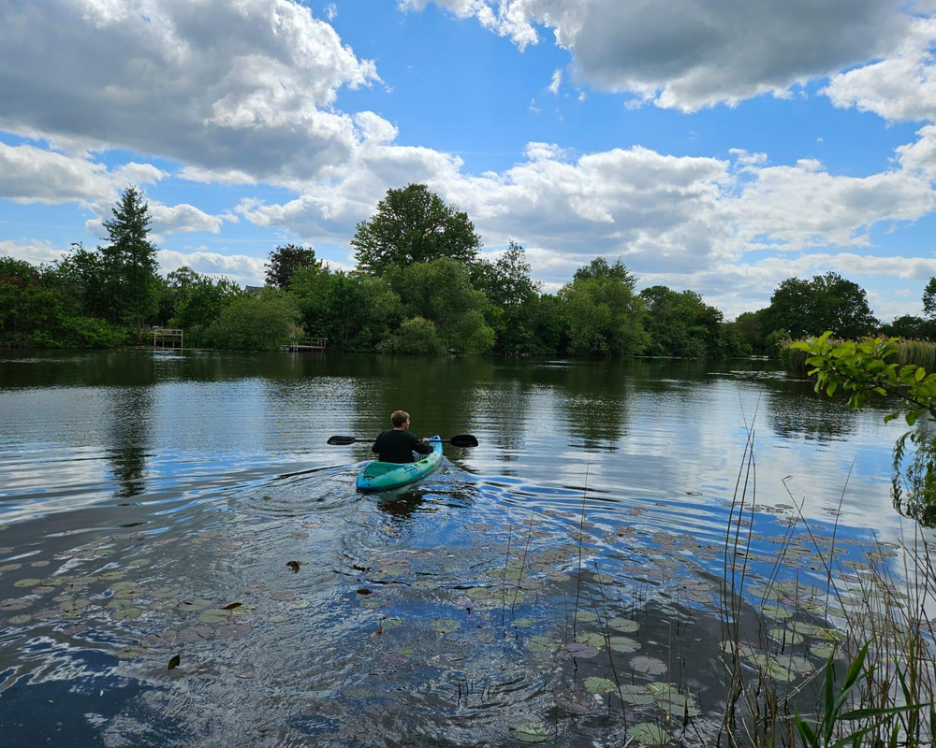
Two kinds of ground
Compare what happens to rainfall on hard, drained ground versus a functioning wetland.
Hard, drained land
Soft, green wetland
Rain runs straight off
Rivers fill up FAST → floods
Soil and dirt wash away
Rain is soaked up
Rivers fill SLOWLY → fewer floods
Water comes out clean
Notes:
Comparison now uses a peat-brown panel for hard/drained land and a real green wetland photo for the soft side, as requested.

Slide 16


A raindrop's journey
Trace a single raindrop through a healthy wetland system, where natural processes do the work.
1
2
3
4
5
Rain falls
Wetland soaks
Water cleaned
Slow release
Homes safe
on fields and wet places
reeds and peat hold it
plants filter the dirt
it trickles out safely
rivers stay low
DID YOU KNOW?
This is a nature-based solution — using a living ecosystem to do work that concrete defences and pumps would otherwise have to do, working with natural processes rather than against them.
Notes:
Raindrop journey now sits in a green watershed/ecosystem band, as requested.

Slide 17
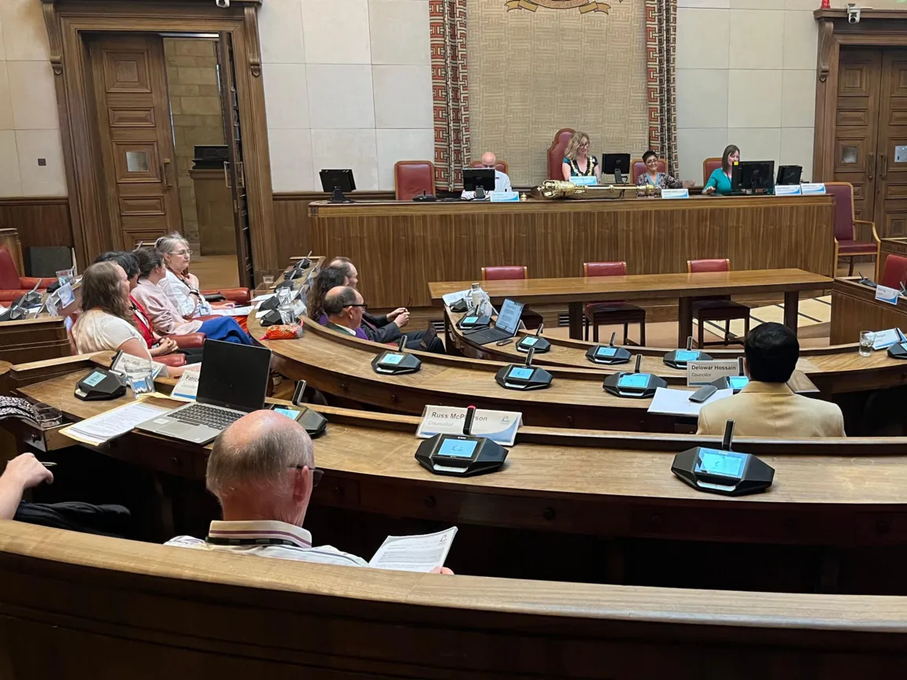
PART 3
Our Plan to Help
Two strands working together to protect and restore the Fens.
Youth voices
Adults together
Workshops like this build understanding among young people across the Fens — and give them a voice in decisions about their landscape.
Councillors, policymakers, farmers, scientists and water companies convene to co-produce practical plans for wetlands as flood defences.
Add photo of youth / GYC
Add photo of Cambridge City Council
DID YOU KNOW?
Raising awareness has real impact. Our Fenlands & Flooding Youth Report sets out how Cambridge could pursue status as an accredited Wetland City — an international designation for cities that protect their wetlands.
Notes:
Plan slide now has placeholders for a youth/GYC photo and a Cambridge City Council photo. Added the message about the Fens flooding report and the goal of becoming an accredited Wetland City (a real international 'Wetland City Accreditation' scheme) — a positive, concrete aim.

Slide 18
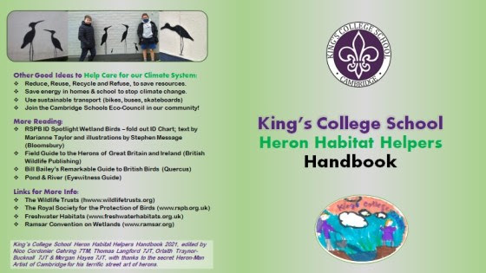
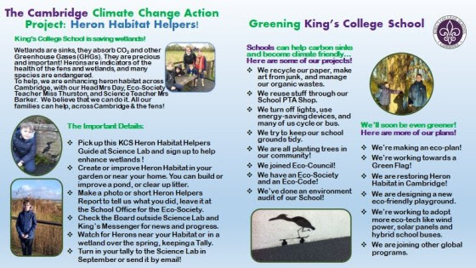

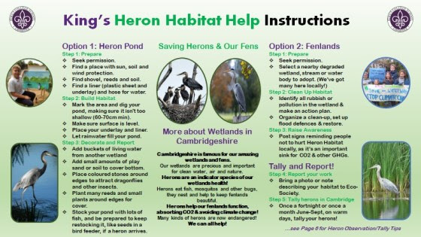
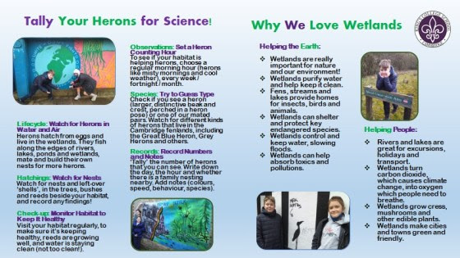
The Heron Habitat Helpers Handbook
We've produced a handbook to help young people protect Fenland wildlife — and we want your feedback to improve it.
What's inside
Spread 1 — Meet the wildlife
The key species and habitats of the Fens.
Spread 2 — How to help
Practical actions young people can take to support habitats.
Spread 3 — Explore near you
Wetlands and nature reserves you can visit.
You'll act as our reviewers — let's work through each section together.
Notes:
New slide 1 of 2 introducing the Habitat Helpers Handbook. Frame the pupils as expert reviewers. Walk through the structure: cover + three spreads + back cover. Next slide is the review/feedback activity.

Slide 19


REVIEW TASK
Help us improve your Heron Habitat
Helpers Handbook
For the cover, each spread and the back cover, give us your strongest ideas and what worked best.
The cover
Spread 1
Spread 2
Spread 3
Back cover
Is it engaging enough to open?
Which species stands out most?
Which action is most convincing?
Which place would you most want to visit?
What's missing? Any bigger ideas?
We'll gather your strongest ideas for each section — the best could make it into the final handbook.
Notes:
New slide 2 of 2: structured feedback walk-through. Go cover → spread 1 → 2 → 3 → back cover. For each, gather what they liked and their best idea, and identify the top content per spread. Capture these — they feed the 'review and improve' of the piloted materials.

Slide 20


What can YOU do?
You've used systems thinking today — here's how to apply it beyond the classroom.
Look closer
Ask 'why?'
Tell others
Care for it
Observe the water, land use and wildlife around you.
Look past the surface event to the underlying causes.
Share what you've learned with others.
Visit, value and help protect wetland habitats.
In a connected system, small individual actions can add up to large-scale change.
Notes:
Colourful 'what you can do' over a real photo of young people on the water.

Slide 21

Find out more…
Recommended resources
Get the materials online
The Great Fen project — great-fen.org.uk
Wicken Fen (National Trust) — visit a real fen
The Wildlife Trusts — wetland wildlife guides
WWT — Wildfowl & Wetlands Trust
RSPB — birds of the Fens
All of today's materials — the slides, the pond-mapping activity and the Heron Habitat Helpers Handbook — will be posted by GYC:
Global Youth Council on Science, Law & Sustainability
www.globalyouthsciencelawsustain.com
Visit the website to access and share the resources.
Get involved: we're recruiting 2–3 students per class for a summer focus group — an online or in-person workshop to review and improve these materials. Details on the next slide.
Notes:
Resources slide with GYC website placeholder (drop in the real URL). Recommended orgs are all real and Fen-relevant. Teases the volunteer focus group, detailed on the final slide.

Slide 22

JOIN THE FOCUS GROUP
Help us improve the materials
Tell me what you think…
Join our focus group to help refine these materials, with invitations to further workshops and opportunities.
Two things to remember
You can sign up now but you can only come to the workshop if:
1. your teacher recommends you, and
2. your parent or guardian gives permission.
Thank you
Notes:
Final call to action. Pass the sign-up sheet around. Be crystal clear: signing up ≠ guaranteed place — they can only attend if BOTH the teacher recommends them AND a parent/guardian gives permission. Workshop is a summer 'review and improve' of the piloted materials, online or in person.

