Slide 1
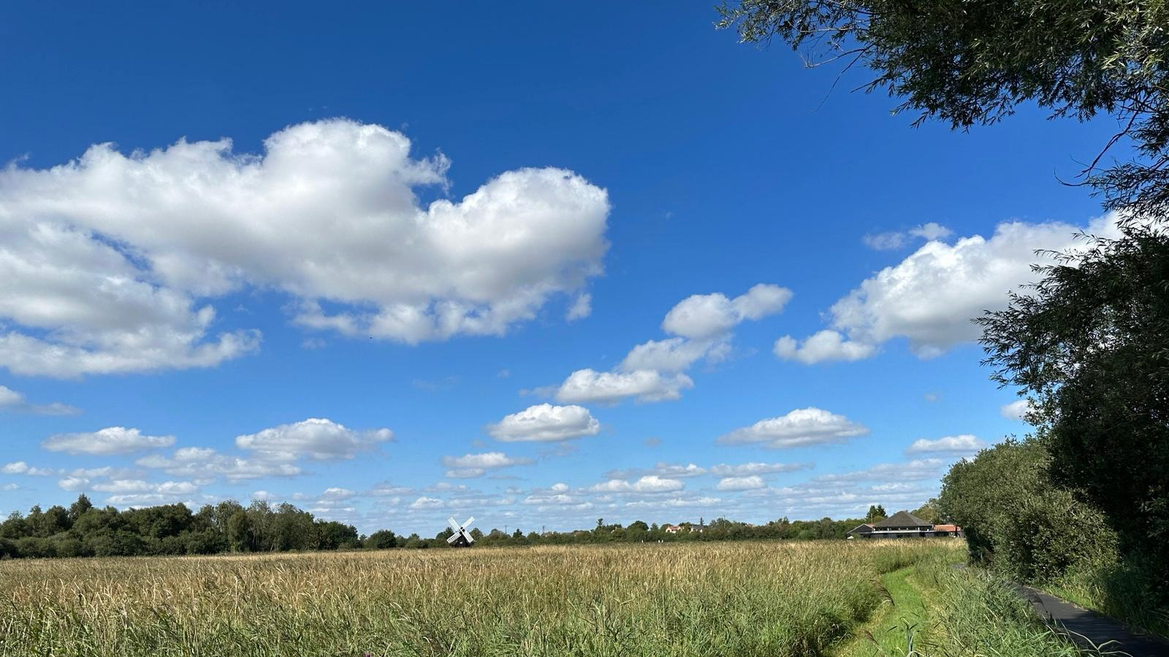
RESTORING OUR FENS
A youth guide to water, wetlands and flooding
Nico
UWC Atlantic College
Vice-Chair, Global Youth Climate (GYC)
Notes:
Title: 'Restoring Our Fens'. Background is a real Fenland photo (windmill & reedbed). Introduce yourself: name, that you're at UWC Atlantic, Vice-Chair of GYC, and a KCS alumnus — this builds a friendly bridge with the pupils. Swap the placeholder for your own photo.

Slide 2




Hello, explorers!
Today we explore the green, wild, watery Fenlands — and how we can bring them back to life.
Think in systems
Explore wetlands
Restore the Fens
See how everything in nature is joined up.
Discover the soggy, buzzing places of the Fens.
Find out how we can heal the land and beat floods.
DID YOU KNOW?
The Fens are one of the biggest flat, low-lying areas in Britain — and a lot of it sits BELOW the level of the sea. Without people looking after it, much of it would be underwater!
Notes:
'Restore' is the key new verb — we're not just learning, we're healing the landscape. Fresh green Fen background. Ask who has seen a very wet field or a flood.

Slide 3
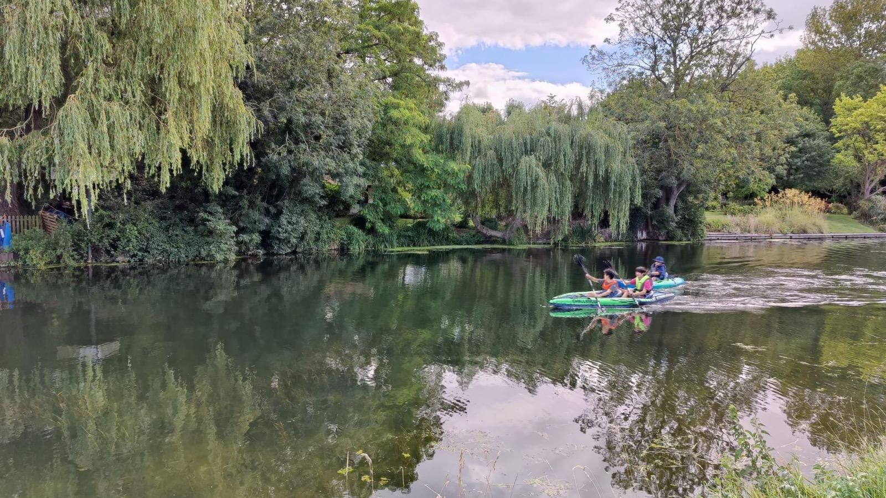
PART 1
Thinking in Systems
A superpower for understanding nature
Willows, water and wildlife on a Cambridgeshire lake
Notes:
Divider for Part 1. The photo shows children kayaking by willows — a living green wetland with people enjoying it. If you have a photo of Kings/Cambridge or otters/swans, this is a good slide to swap it in.

Slide 4


Everything is connected
A system is a group of things that work together and affect each other — like a spider's web.
…the whole web shakes
If you poke one part of a system, every other part feels it.
Nature is the biggest web of all. A pond, a wetland, the whole Fens — touch one strand and everything connected to it moves too.
Pull one thread…
Notes:
Spider-web metaphor ONLY (other examples removed). Get a pupil to mime pulling a thread and watch the whole web shake. Land the idea that nature is a giant connected web — this sets up the pond-drawing activity next.

Slide 5

LET'S GET DRAWING!
Draw your own pond web
Be a systems scientist: show how the living things in a pond are all connected.
Your mission
Think like a scientist
1
Draw a pond in the middle of your paper.
2
Add animals, plants, insects and the water — frogs, fish, reeds, dragonflies, birds…
What happens to your whole web if the pond dries up?
That's exactly what systems scientists ask about the real Fens!
3
Now draw arrows between them to show how they need each other.
4
Who eats who? Who needs the water? Who needs the plants?
Notes:
Hands-on drawing activity (replaces abstract examples). Hand out paper. Let them draw a pond, add living things, then arrows for connections. Circulate and prompt 'who needs who?'. Next slide shows your model answer and praises their work.

Slide 6






Brilliant work, Scientists!
Here's one way to draw it — but every web is different, and yours might be even better!
Heron
Give yourselves a clap!
Frog
Fish
POND
Every arrow you drew shows you understand something powerful: in nature, nothing lives alone. You're thinking like real systems scientists.
Reeds
Insects
Put your name, age and school on the back of your drawing — your artwork might be published online by GYC!
Notes:
Show YOUR model pond web and warmly praise their drawings — find specific good ideas in the room. Note the footer: name/age/school on the back, may be published online by GYC (get the usual permissions). Keep the praise genuine and specific.

Slide 7
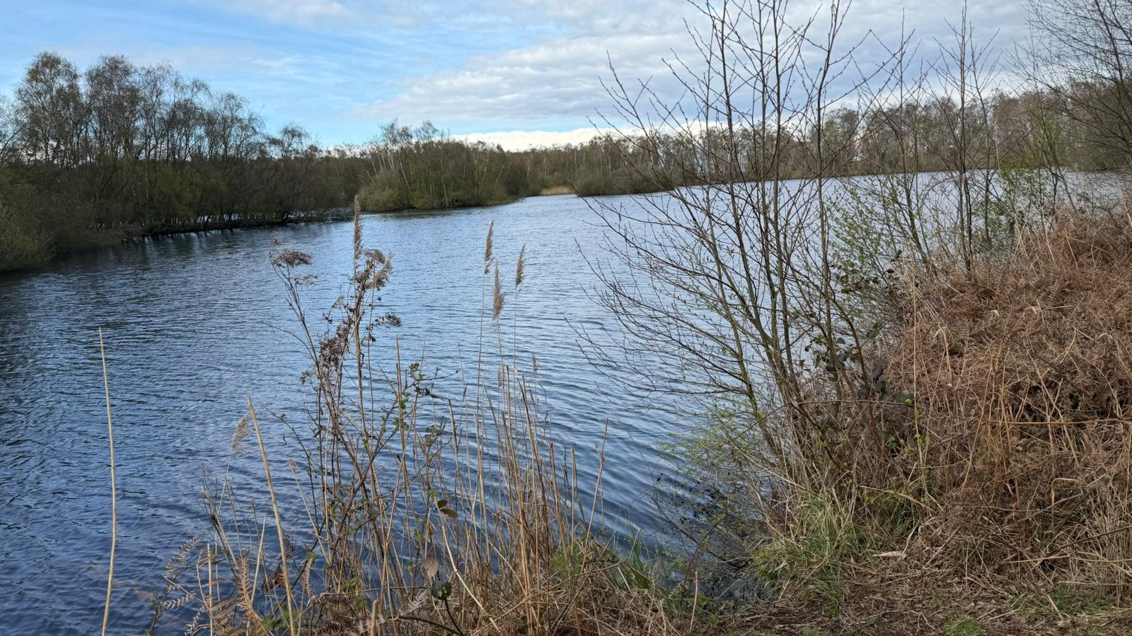


Round and round: A loop
Sometimes a change loops back and makes itself even bigger.
We drain
More water
Soil sinks
Draining dries the peat → the land sinks → there's more water to pump → so we drain even harder. Round and round!
Notes:
Feedback loop over a real Fen lake photo. Walk the loop with a finger. This vicious cycle is why the problem is tricky — and why restoring wetlands breaks the loop.

Slide 8
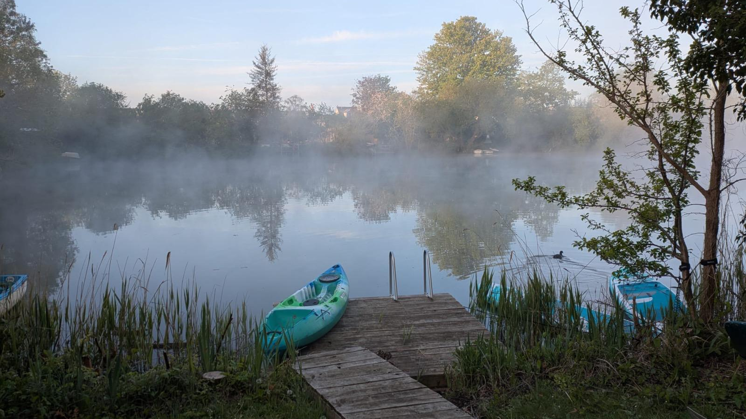
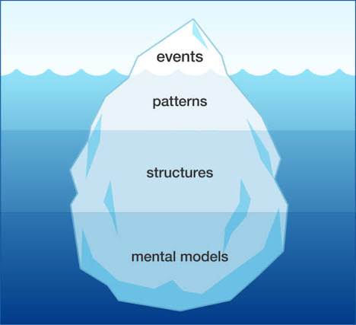
Look under the surface
When we see a flood, that's just what's on top. A systems scientist asks: what's really going on underneath?
What we SEE: A field has flooded
Underneath: It rained a lot and rivers are high
Deeper: Wetlands were drained — water has nowhere to go
Deepest: Long ago we chose farmland over wet land
This way of looking — past the surface to the hidden causes — is called an ICEBERG DIAGRAM.
Notes:
Reframed as you asked: lead with 'what we see in a flood vs the underlying factors', THEN name it an iceberg diagram at the end. Misty dawn photo suits the 'hidden depths' idea. Encourage 'why?' questions to dig down the layers.

Slide 9
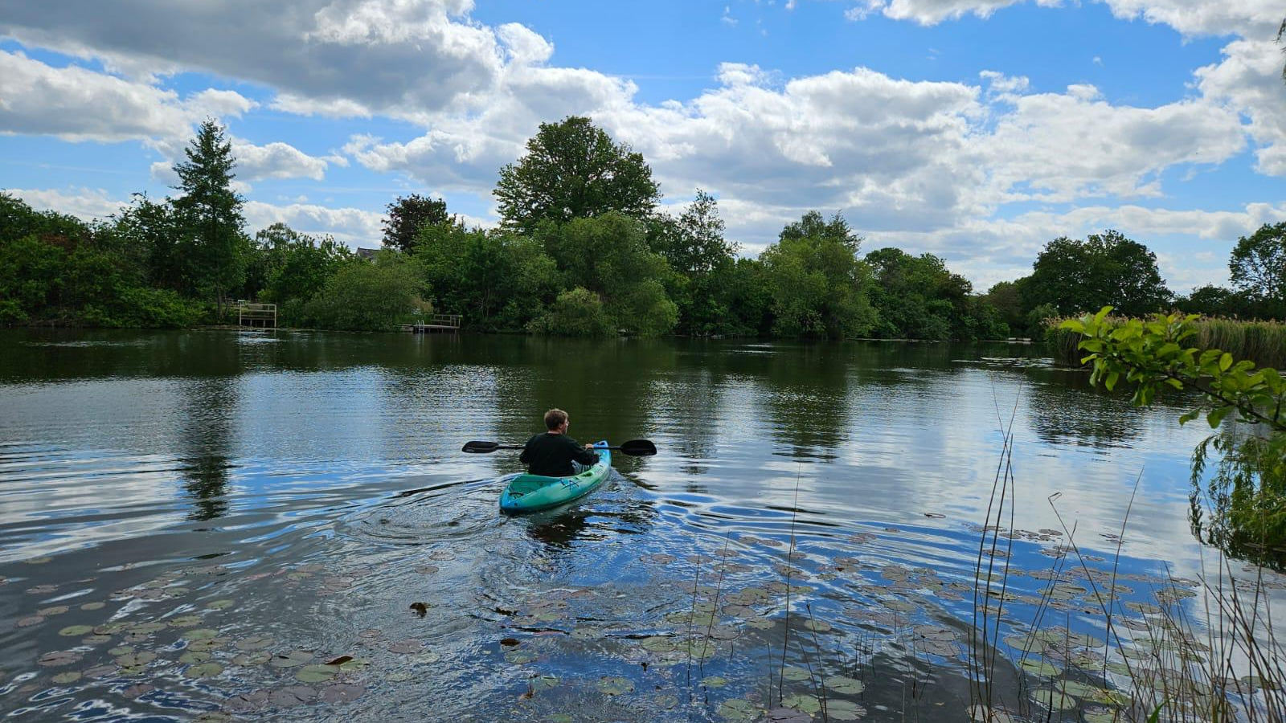
PART 2
Wetlands & the Fens
Soggy superheroes that fight the floods
Notes:
Divider for Part 2 over a lily-pad lake photo.

Slide 10
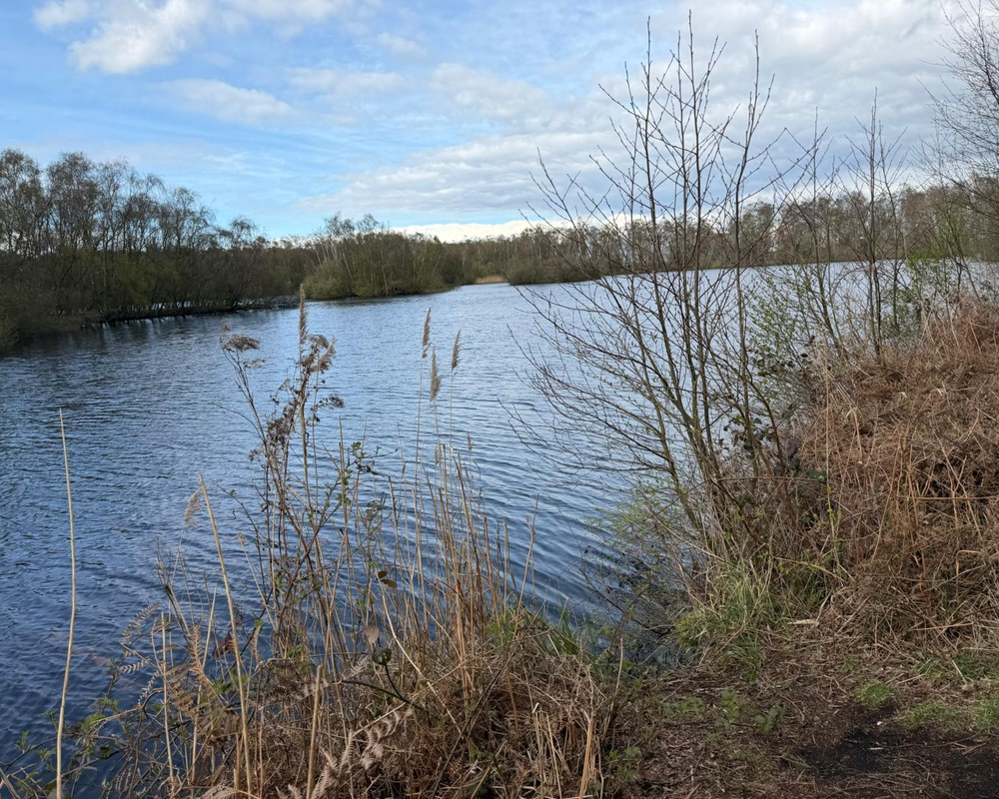



What is a wetland?
Land that is soaked with water for much of the year — half land, half water, and full of life.
Always soggy
Reeds & rushes
A giant natural sponge.
Tall water-loving plants.
Bursting with life
Cleans water
Birds, frogs, fish & bugs.
Plants filter out the dirt.
A real Fenland wetland
Notes:
Lovely content kept, design swapped to use a real wetland photo panel. Wicken Fen is the nearby living example if pupils have visited.

Slide 11




The story of the Fens
Our landscape near Cambridge has changed enormously — it wasn't always farmland.
Long ago
People drain it
Rich farmland
The catch
One huge wetland — water, reeds and wildlife everywhere.
~400 years ago, ditches and pumps drained the water away.
The drained peat grew brilliant crops and food.
Dry peat shrinks and sinks — now lower than the rivers!
Over to you! Can you name a really OLD town or place in the Fens… and a really NEW one? (Think Ely, Wicken, Whittlesea — or a brand-new housing estate!)
Add photos: Holme Fen, Wicken Fen, River Cam, Ouse, Nene
Notes:
Story kept (terrific content). Added: a place-name quiz to involve them (old vs new place in the Fens), and a photo strip placeholder for Holme Fen, Wicken Fen, and the Cam/Ouse/Nene rivers — drop those in when you have them.

Slide 12
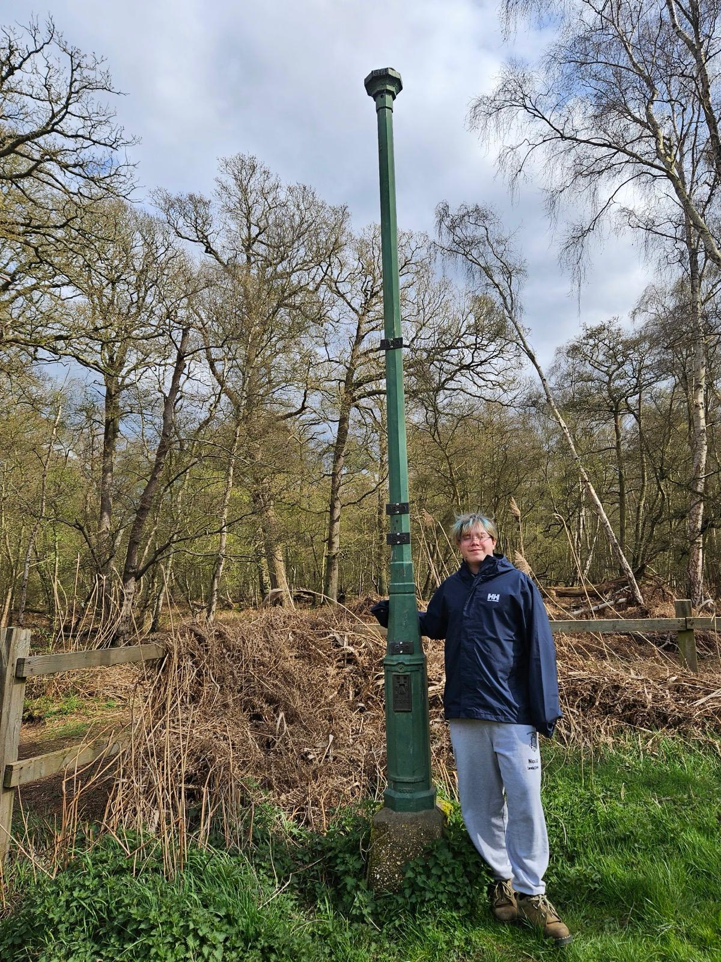

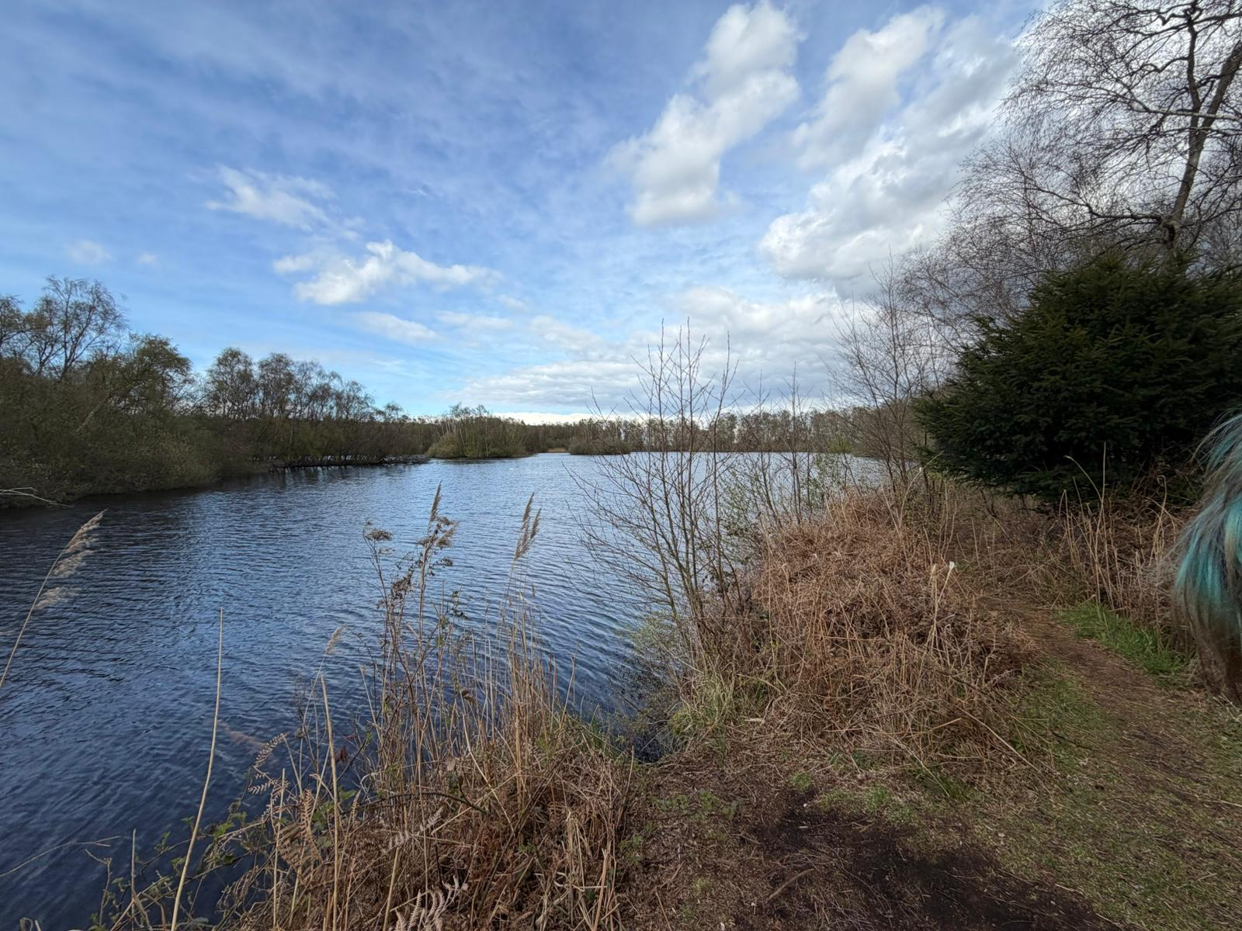
The sinking land
When wet peat dries out it shrinks — like a sponge left in the sun. At Holme Fen we can measure it.
How big is 4 metres?
The Holme Fen Post
More than TWO Adults
standing on each other's shoulders!
In 1848 an iron post was hammered in, level with the ground. The land has since dropped about 4 metres — the post now towers above it.
≈ 4 m
DID YOU KNOW?
Holme Fen is now the lowest land in all of Great Britain — about 2.75 m below the sea!
Notes:
Maths check you asked for: subsidence ≈4 m. An average adult man ≈1.75 m, so 4 ÷ 1.75 ≈ 2.3 — i.e. more than TWO 'Mr Deely's tall, not three (three would need him ~1.33 m). I've drawn ~2.3 people and phrased it as 'more than two grown-ups on each other's shoulders' to stay accurate. Swap in the real post photo you took.

Slide 13



Why does it flood?
In the Fens, many rivers sit HIGHER than the fields beside them.
When the rain pours…
River up here!
If the high rivers overflow or a bank breaks, water floods the low fields and homes below.
Pump lifts water UP
DID YOU KNOW?
Pumps run almost every day to push water UP into the rivers — the opposite of how water normally flows!
Low field
Low field
The land sank, but the rivers stayed up — held in by banks called embankments.
Notes:
Design refreshed with a real Fen photo background; cross-section content kept. Explain the perched rivers and pumps lifting water uphill.

Slide 14


Wetlands to the rescue!
A wetland works like a giant sponge — soaking up flood water and letting it out slowly and safely.
Soaks it up
Slows it down
Protects homes
Homes for wildlife
Spongey ground holds huge amounts of rain.
Reeds slow the water so rivers rise gently.
Safer towns, farms and roads.
Clean water AND a place for animals to live.
DID YOU KNOW?
Just one hectare of healthy wetland (about a rugby pitch) can store millions of litres of water — and give a home to thousands of creatures at the same time.
Notes:
Colourful design over a lily-pad lake photo, emphasising wildlife and homes as you asked.

Slide 15
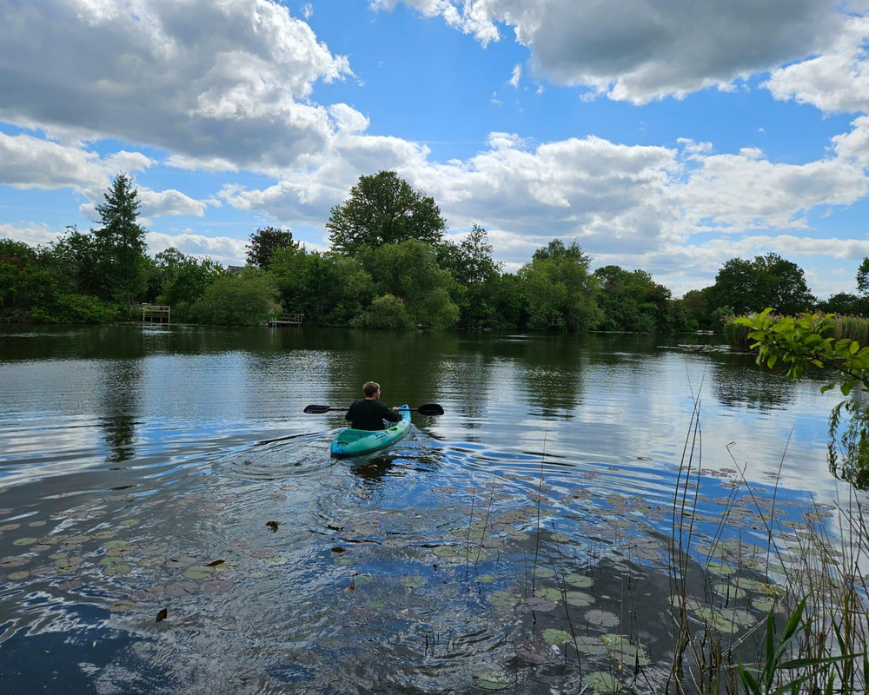
Two kinds of ground
What happens to rain when it lands on hard, drained land versus a soft, green wetland?
Hard, drained land
Soft, green wetland
Rain runs straight off
Rivers fill up FAST → floods
Soil and dirt wash away
Rain is soaked up
Rivers fill SLOWLY → fewer floods
Water comes out clean
Notes:
Comparison now uses a peat-brown panel for hard/drained land and a real green wetland photo for the soft side, as requested.

Slide 16


A raindrop's journey
Follow one raindrop across a healthy green wetland, with nature doing the work for us.
1
2
3
4
5
Rain falls
Wetland soaks
Water cleaned
Slow release
Homes safe
on fields and wet places
reeds and peat hold it
plants filter the dirt
it trickles out safely
rivers stay low
DID YOU KNOW?
This is a "nature-based solution" — letting a living, green ecosystem do a job that concrete and pumps would otherwise have to do. It works WITH nature, not against it.
Notes:
Raindrop journey now sits in a green watershed/ecosystem band, as requested.

Slide 17
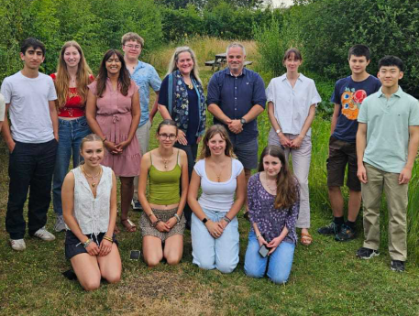
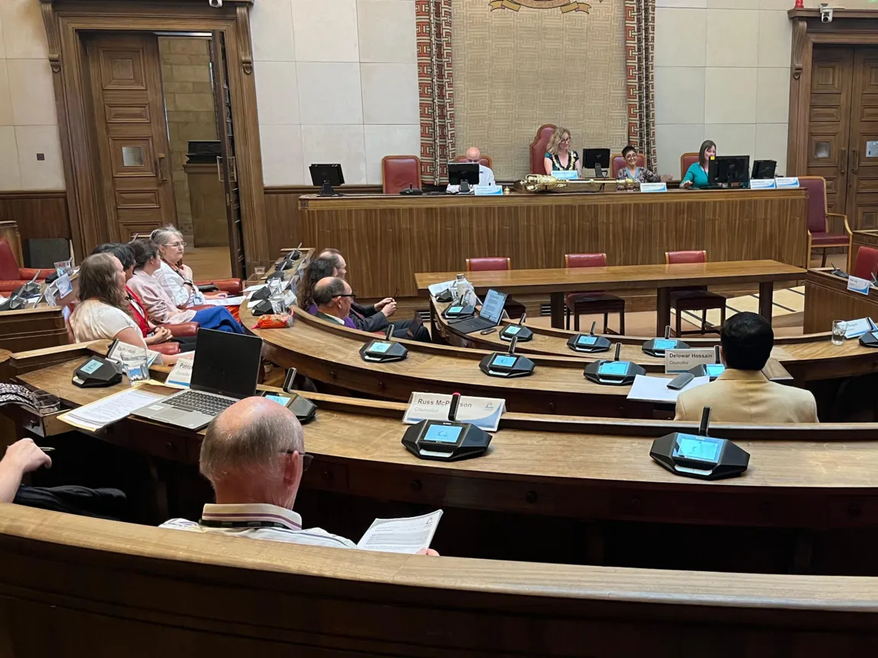
PART 3
Our Plan to Help
Two big ideas, working together to protect and restore the Fens.
Youth voices
Adults together
Workshops like this help young people across the Fens understand their water and wetlands — and speak up for them.
Councillors, experts, policy leaders, farmers, scientists and water companies meet to agree real plans for wetlands as flood defences.
Add photo of youth / GYC
Add photo of Cambridge City Council
DID YOU KNOW?
We can do a LOT just by raising awareness. By caring for our wetlands, our Fenlands & Flooding Youth Report shows Cambridge could even become an accredited Wetland City — a special title for places protect their wetlands.
Notes:
Plan slide now has placeholders for a youth/GYC photo and a Cambridge City Council photo. Added the message about the Fens flooding report and the goal of becoming an accredited Wetland City (a real international 'Wetland City Accreditation' scheme) — a positive, concrete aim.

Slide 18
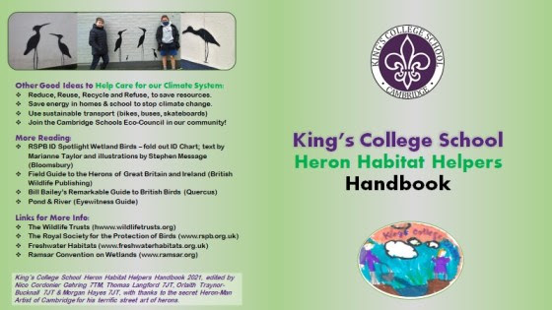
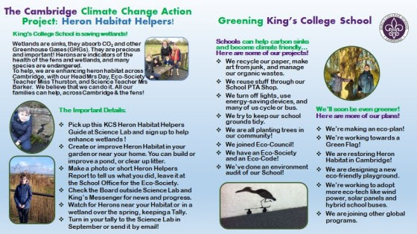

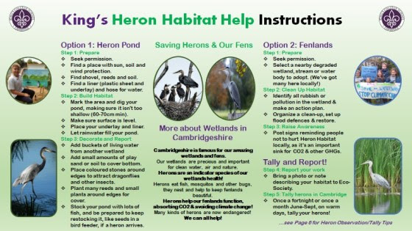
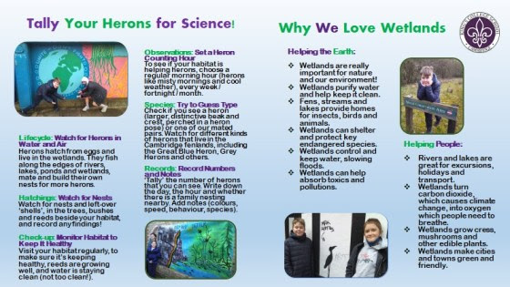
The Heron Habitat Helpers Handbook
We've made a handbook to help young people care for Fenland wildlife — and we'd love YOUR ideas to make it better.
What's inside
Spread 1 — Meet the wildlife
The amazing animals and plants of the Fens.
Spread 2 — How to help
Simple things young people can do for habitats.
Spread 3 — Explore near you
Wetlands and nature spots to visit.
You'll be our expert reviewers — let's look at each part together.
Notes:
New slide 1 of 2 introducing the Habitat Helpers Handbook. Frame the pupils as expert reviewers. Walk through the structure: cover + three spreads + back cover. Next slide is the review/feedback activity.

Slide 19


BE OUR REVIEWERS!
Help us improve your Heron Habitat
Helpers Handbook
For the cover, each spread, and the back cover — tell us your best ideas and what you liked most.
The cover
Spread 1
Spread 2
Spread 3
Back cover
Does it make you want to open it?
Which animal is your favourite?
Which 'how to help' idea is best?
Where would you most like to visit?
What's missing? Any big ideas?
We'll collect your top ideas for each part — the best ones could go into the real handbook!
Notes:
New slide 2 of 2: structured feedback walk-through. Go cover → spread 1 → 2 → 3 → back cover. For each, gather what they liked and their best idea, and identify the top content per spread. Capture these — they feed the 'review and improve' of the piloted materials.

Slide 20


What can YOU do?
You're a systems thinker now — here's how to use your new science skills.
Look closer
Ask 'why?'
Tell others
Care for it
Notice the water and wildlife near you.
Look under the surface for hidden causes.
Share what you've learned.
Visit and protect soggy, wild places.
Small actions join up into big change — in a system!
Notes:
Colourful 'what you can do' over a real photo of young people on the water.

Slide 21

Find out more…
Recommended resources
Get the materials online
The Great Fen project — great-fen.org.uk
Wicken Fen (National Trust) — visit a real fen
The Wildlife Trusts — wetland wildlife guides
WWT — Wildfowl & Wetlands Trust
RSPB — birds of the Fens
All of today's materials — slides, the pond-web activity and the Habitat Helpers Handbook — will be posted by GYC:
Global Youth Council on Science, Law & Sustainability
www.globalyouthsciencelawsustain.com
Ask a teacher or adult to help you visit our website.
Calling all keen explorers! We're looking for 2–3 pupils per class to join a summer focus group — an online or in-person workshop to review and improve these materials. More on the next slide!
Notes:
Resources slide with GYC website placeholder (drop in the real URL). Recommended orgs are all real and Fen-relevant. Teases the volunteer focus group, detailed on the final slide.

Slide 22

BECOME A FOCUS-GROUP EXPLORER
Help us finish the job
Tell me what you think…
Join our ‘focus group’ and receive invitations to further workshops… and other opportunities!
Two things to remember
You can sign up now but you can only come to the workshop if:
1. your teacher recommends you, and
2. your parent or guardian gives permission.
Thank you
Notes:
Final call to action. Pass the sign-up sheet around. Be crystal clear: signing up ≠ guaranteed place — they can only attend if BOTH the teacher recommends them AND a parent/guardian gives permission. Workshop is a summer 'review and improve' of the piloted materials, online or in person.

